Slide 1
RShiny and RMarkdown

Slide 2
The Data Science Pipeline

Slide 3
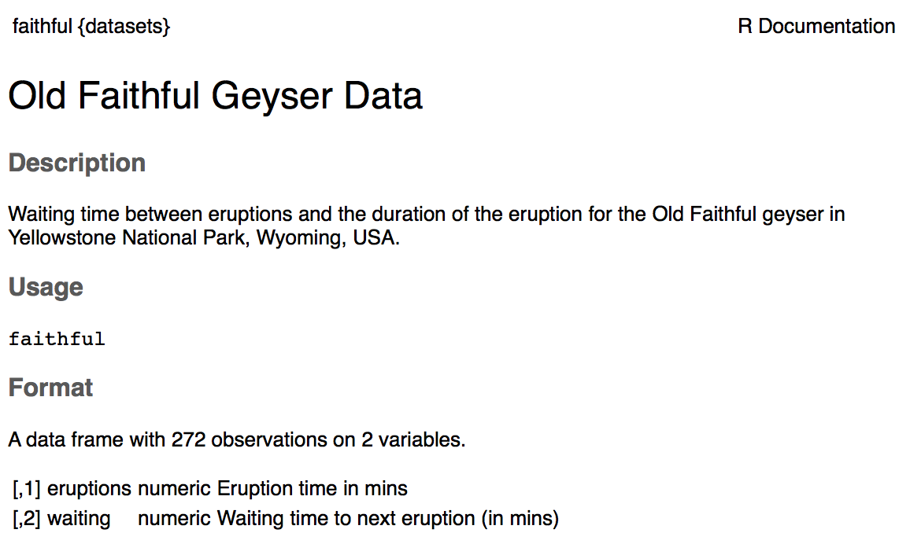
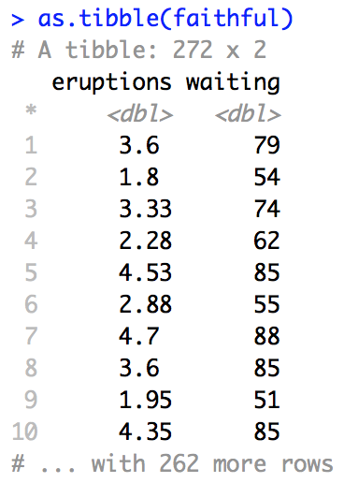
Old Faithful Data

Slide 4
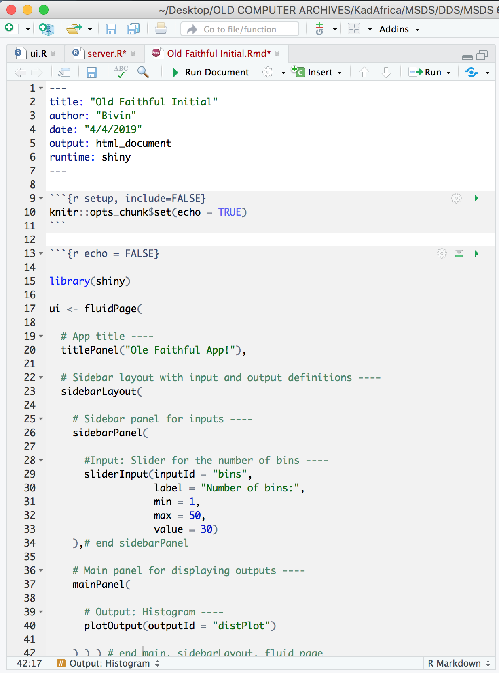
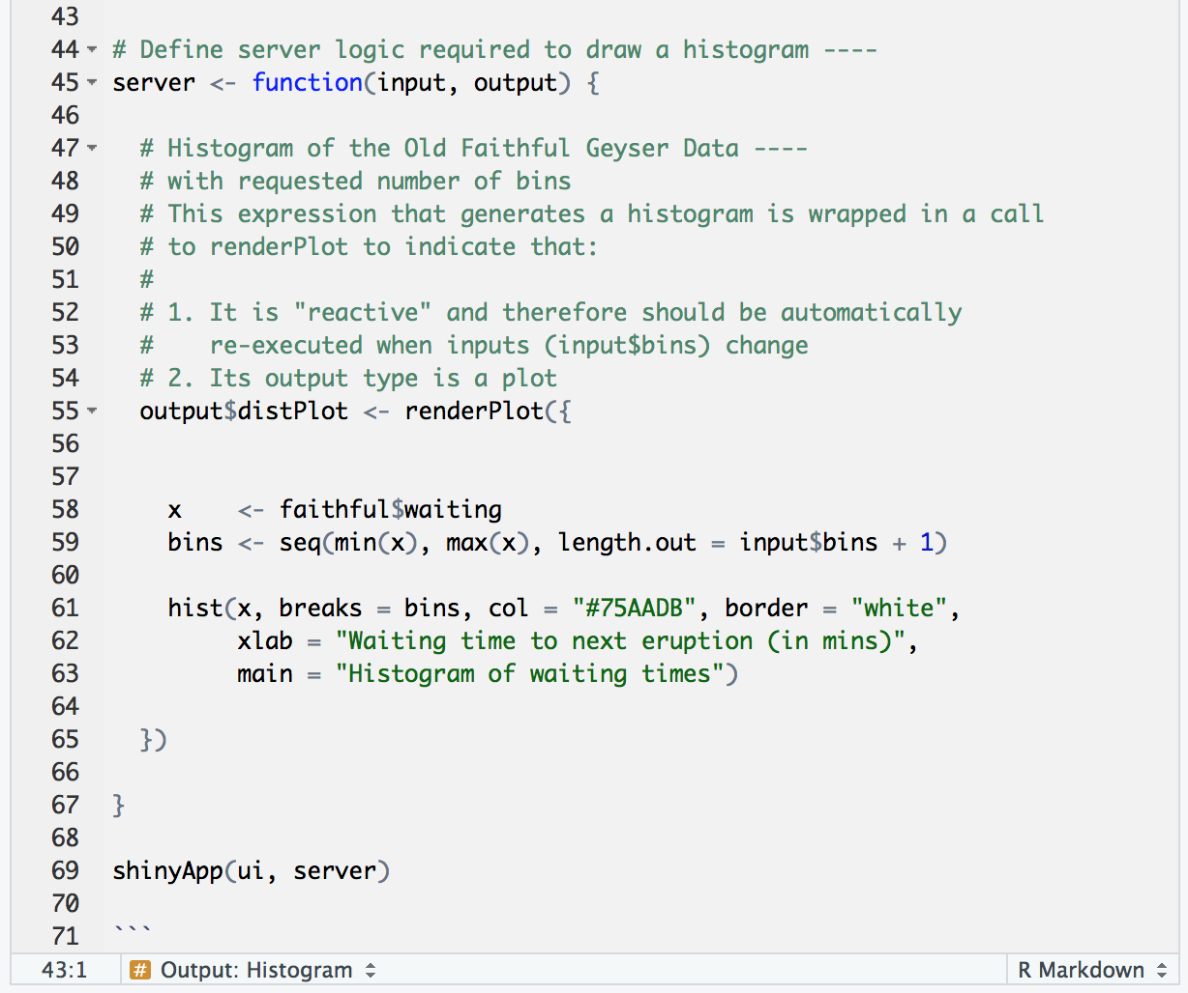
RShiny | RMarkdown

Slide 5
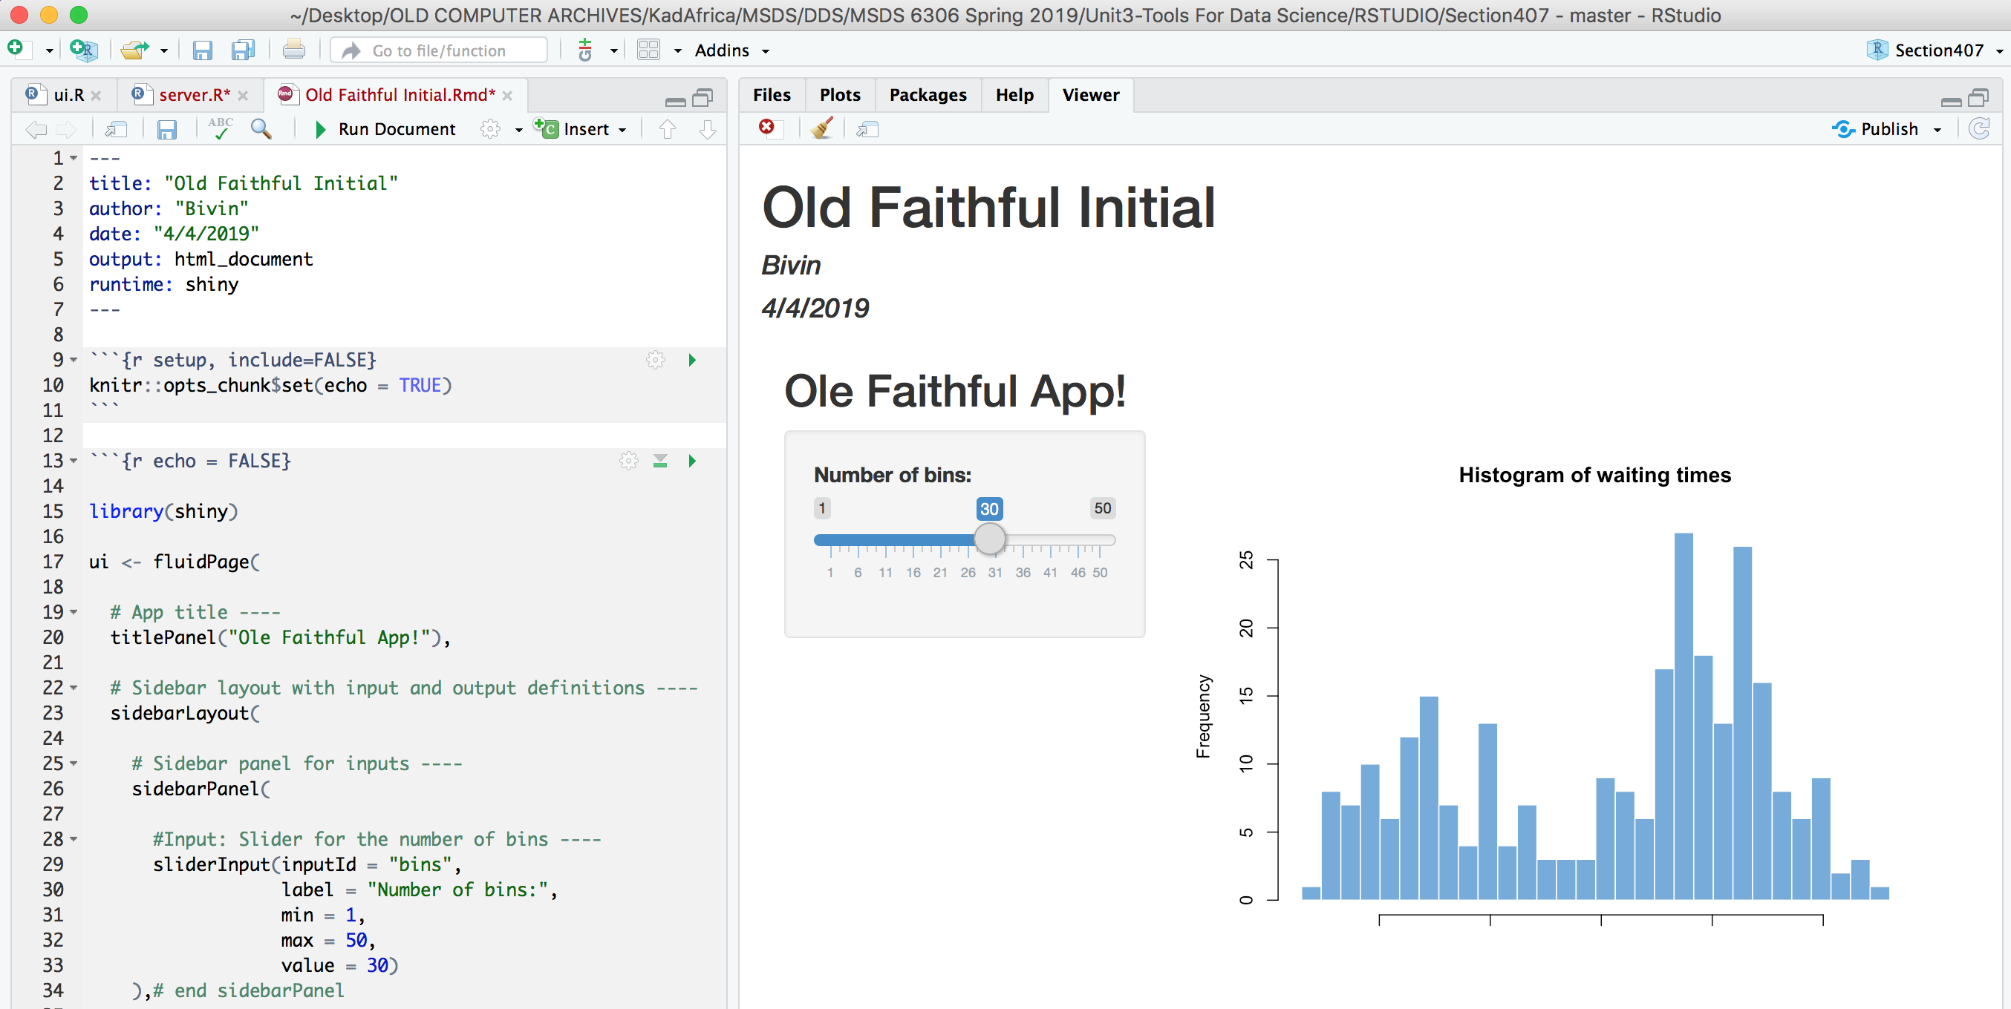
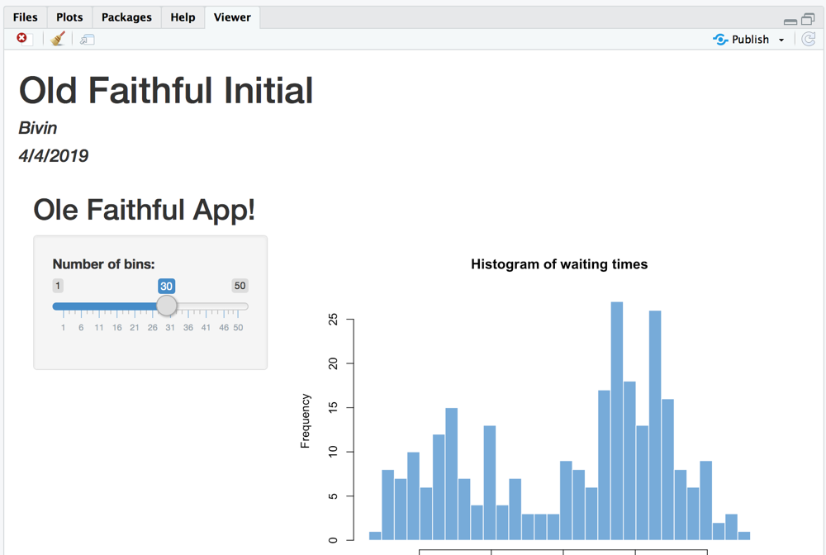

RShiny | RMarkdown

Slide 6
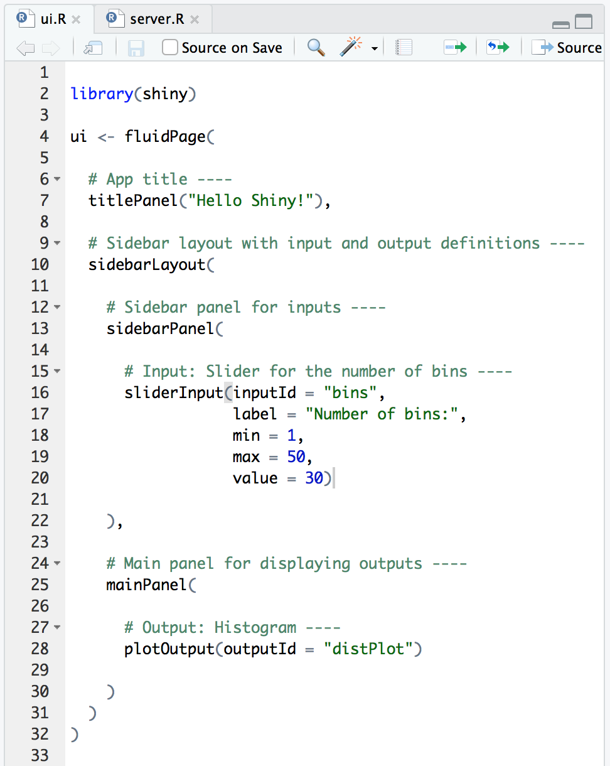
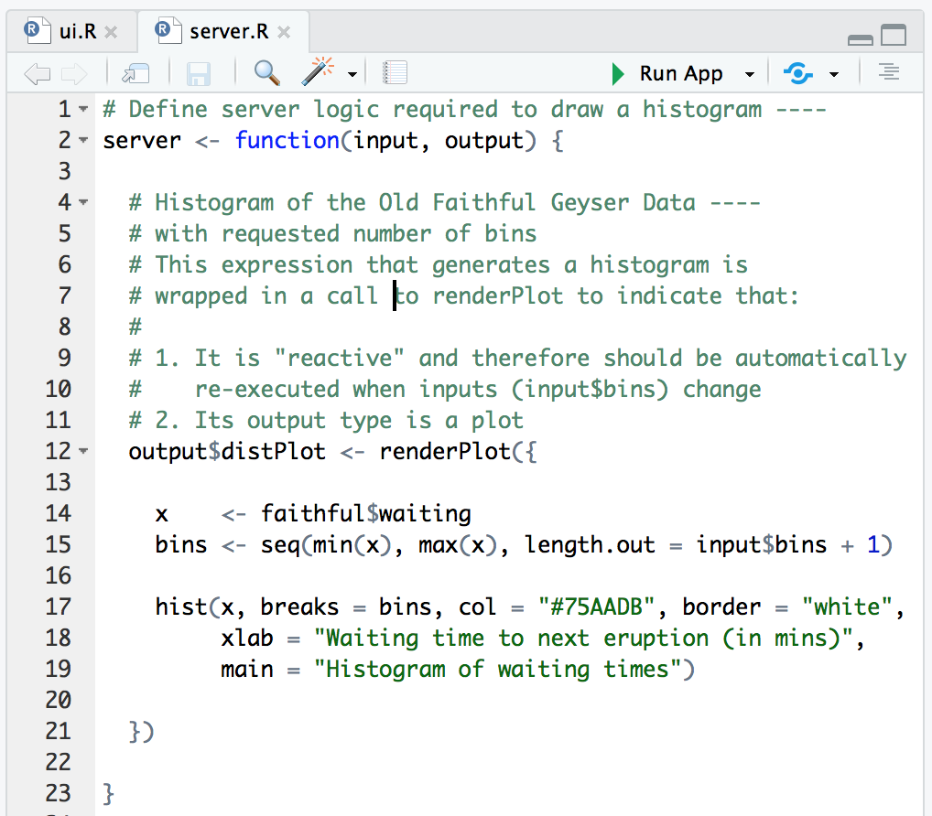
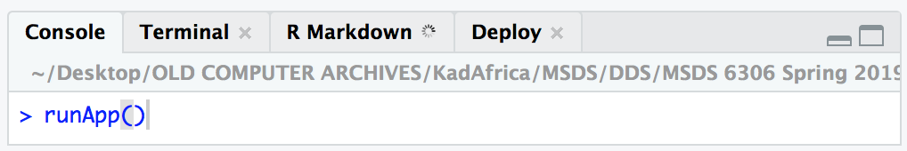
RShiny | Separate Client and Server

Slide 7
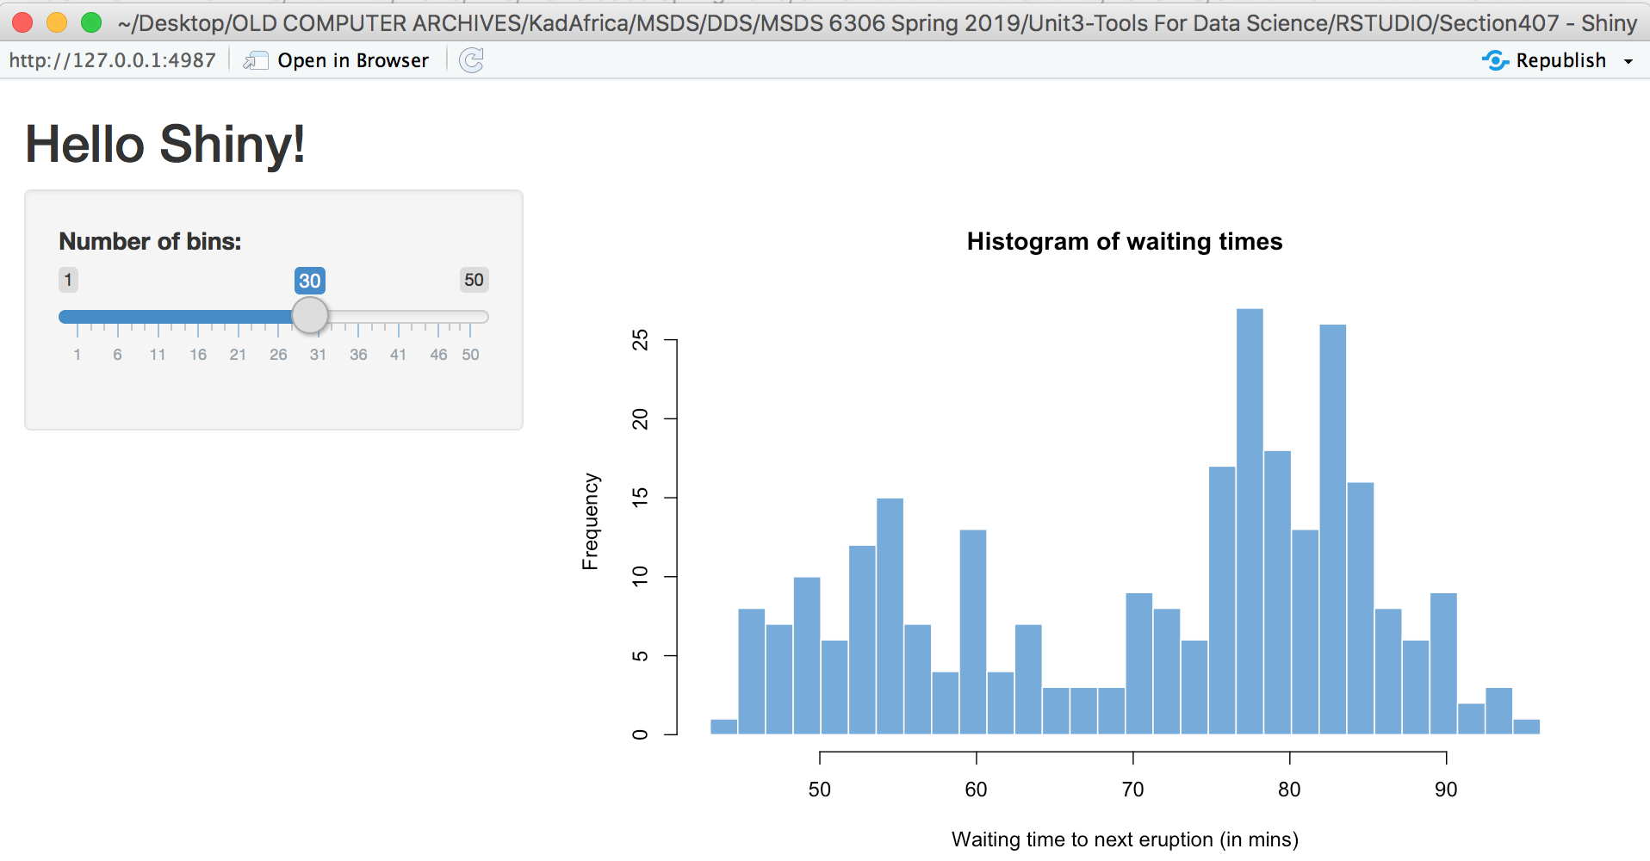
RShiny | Separate Client and Server

Slide 9
RShiny and Shinyapps.io

Slide 10
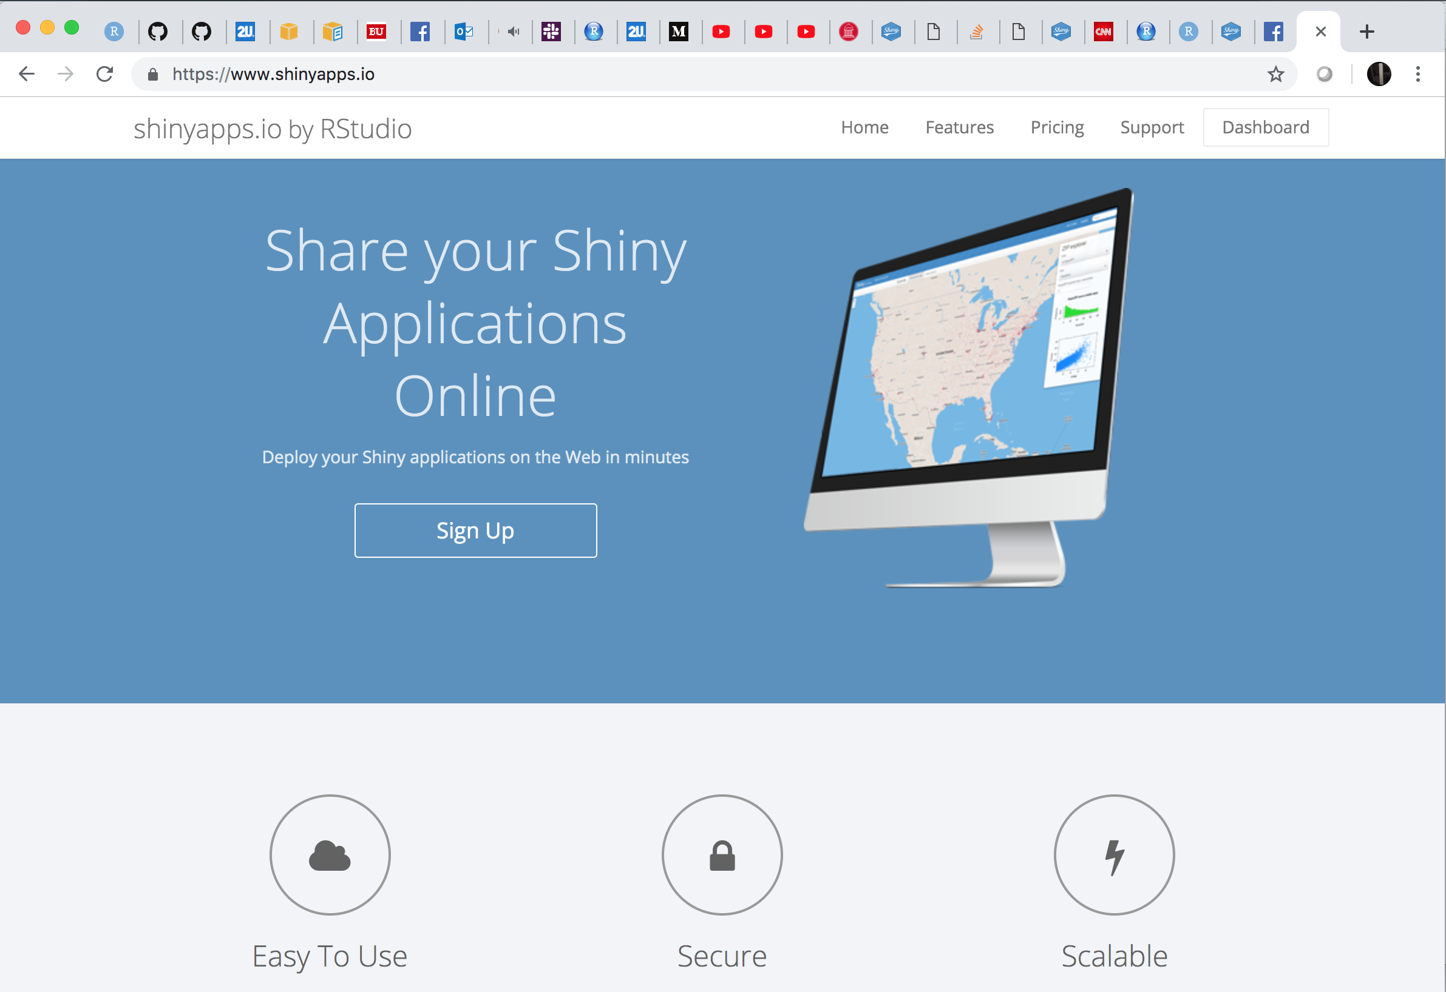
Rshiny | Deploy to Shinyapps.io
https://www.shinyapps.io/

Slide 11
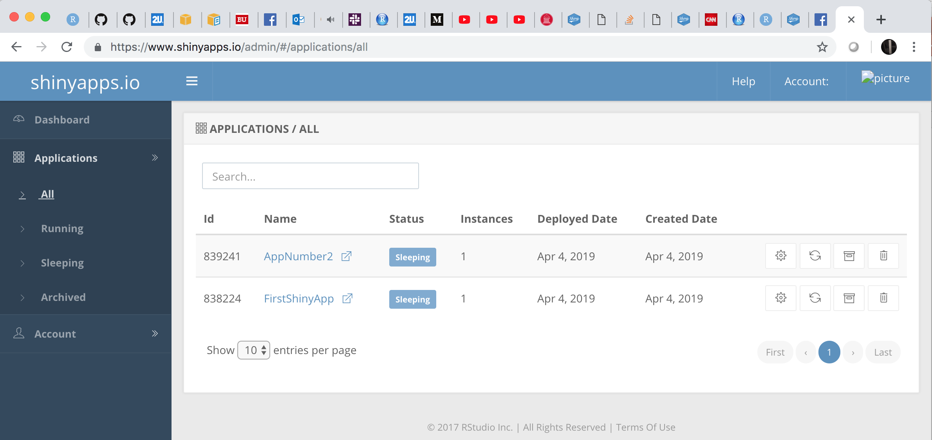
Rshiny | Deploy to Shinyapps.io
https://www.shinyapps.io/

Slide 12
RShiny | Separate Client and Server

Slide 13
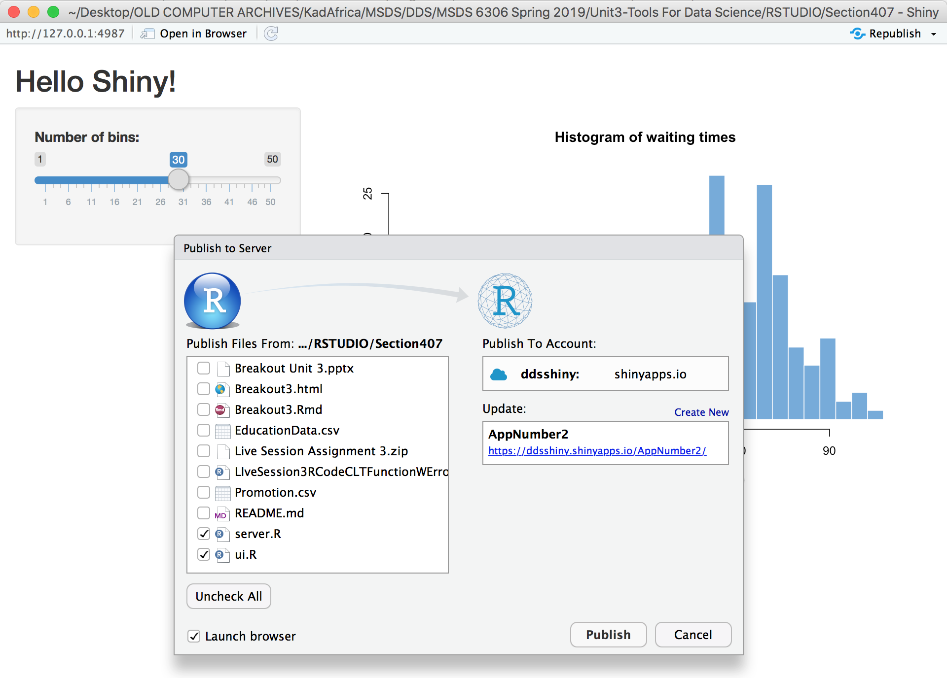
Rshiny | Deploy to Shinyapps.io

Slide 14
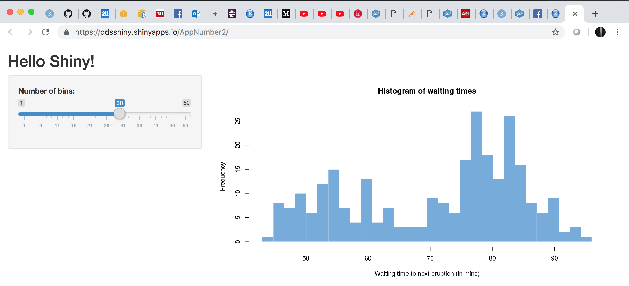
Rshiny | Deploy to Shinyapps.io

Slide 16
Example 1: The Simplest Website

Slide 17
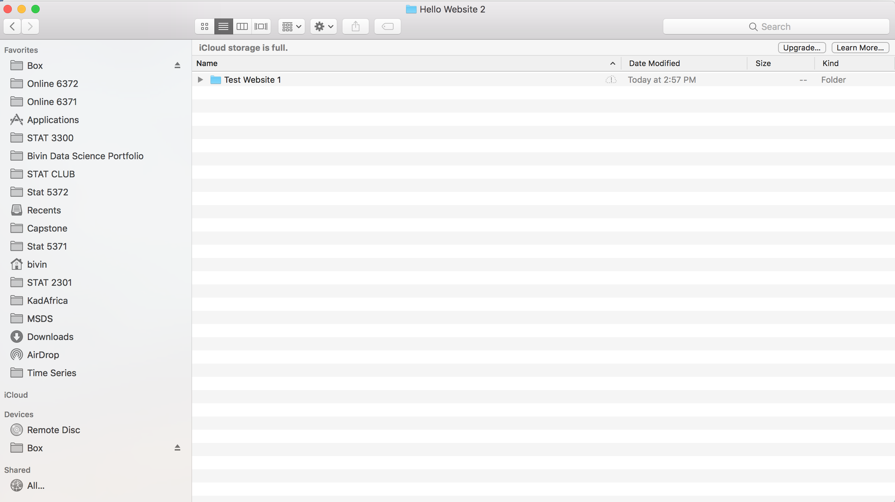
Websites with GitHub! | Simplest

Slide 18
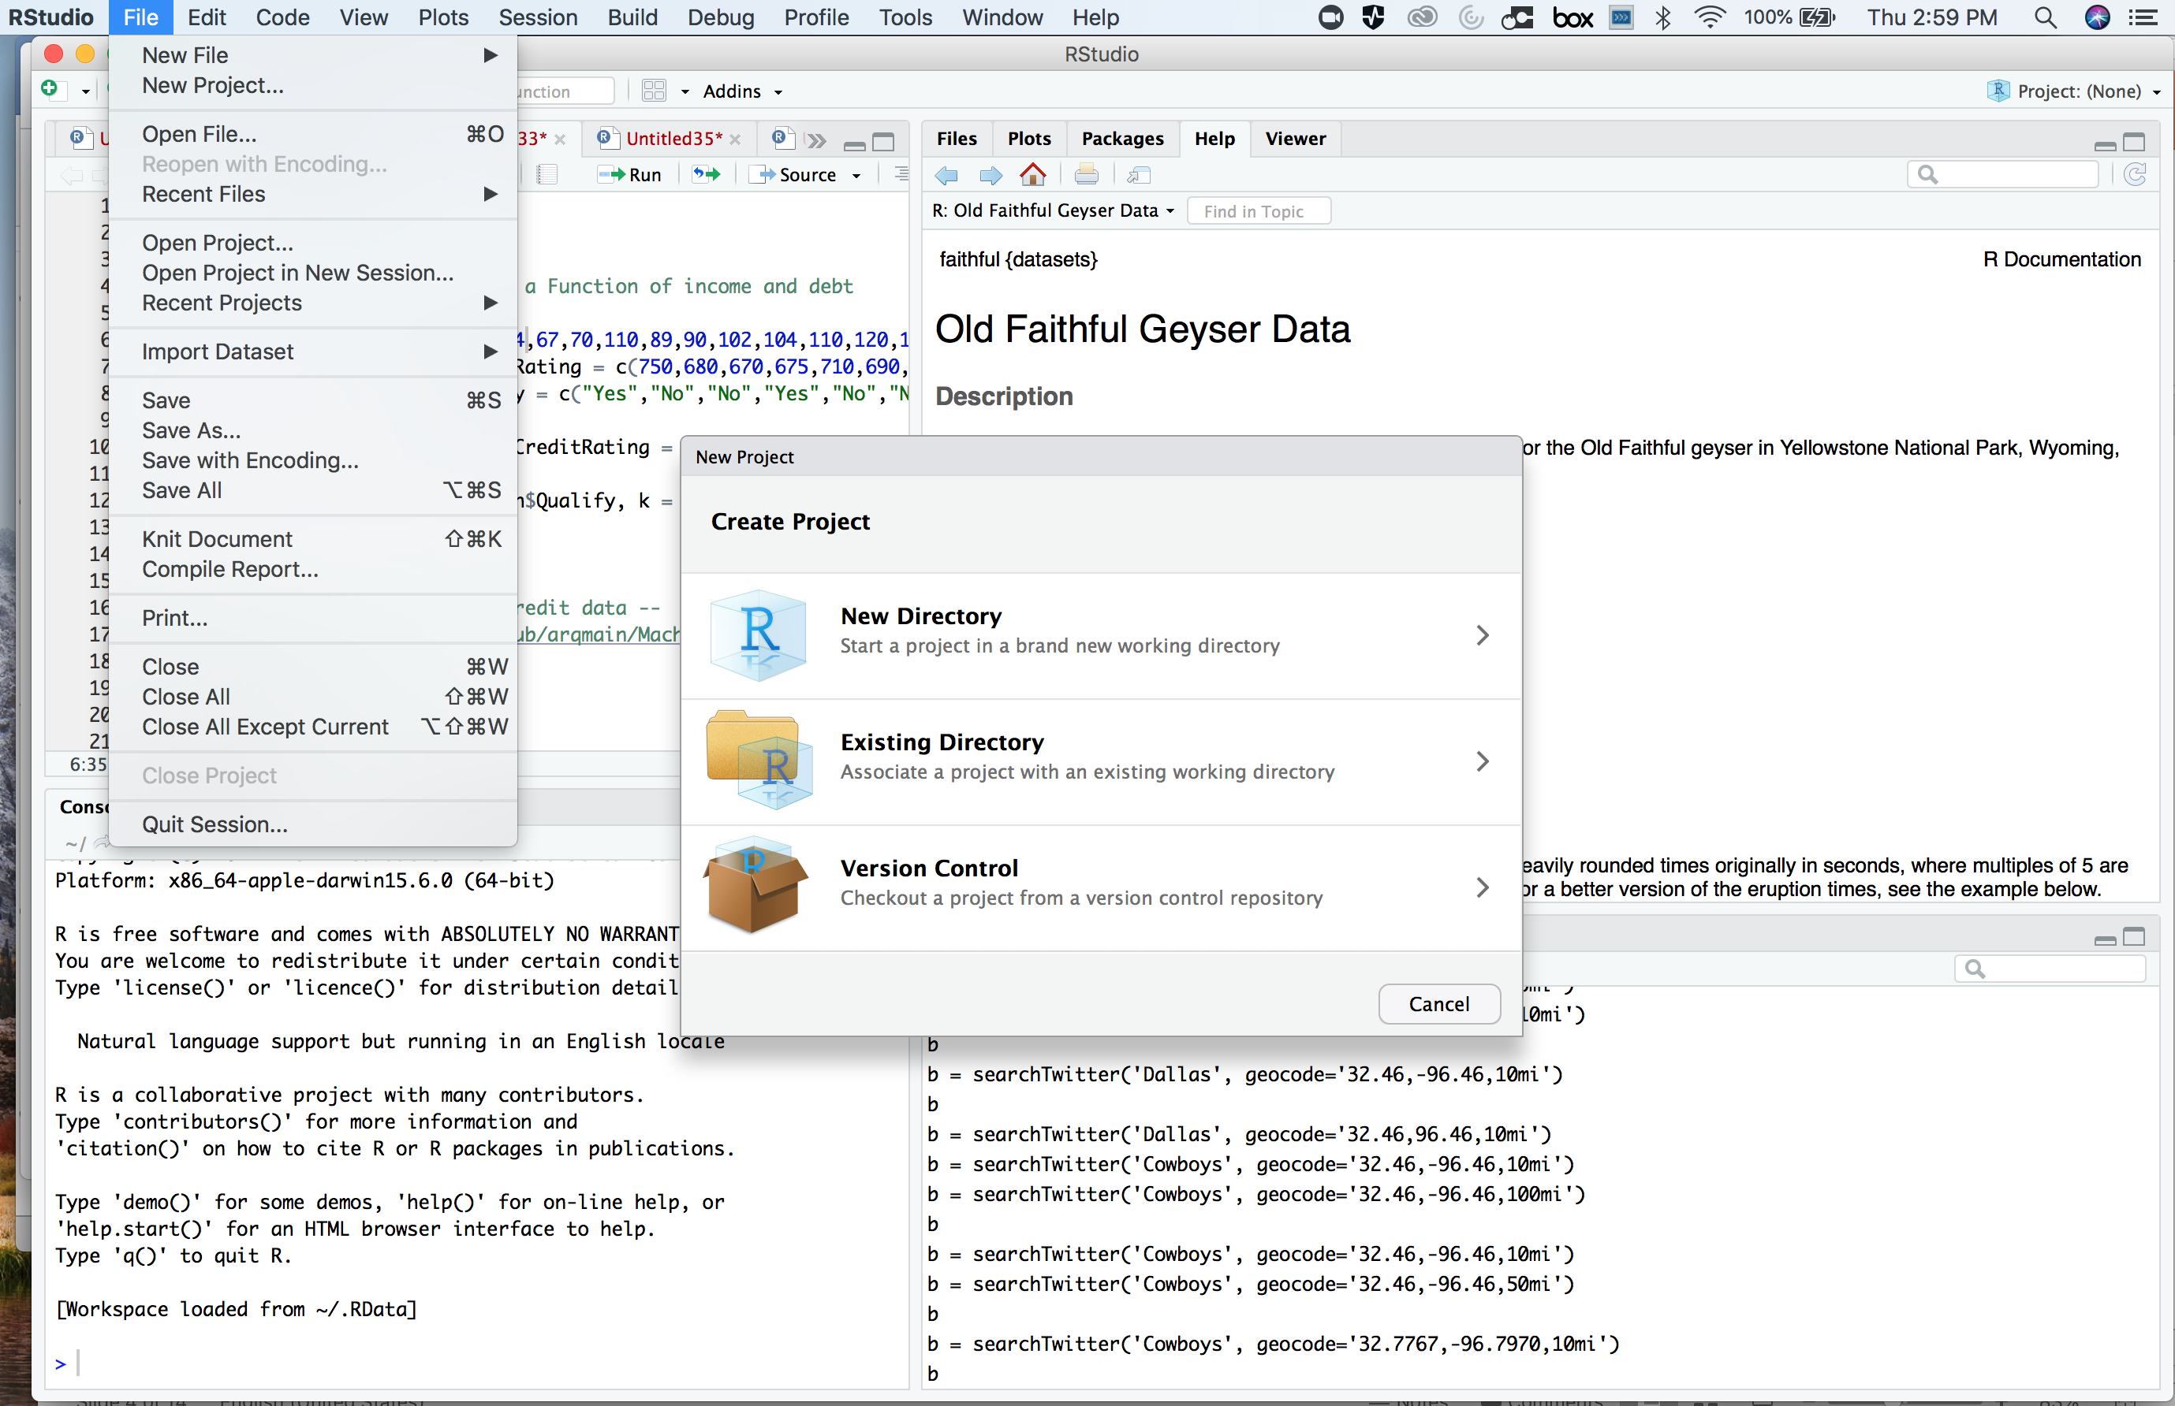
Websites with GitHub! | Simplest

Slide 19
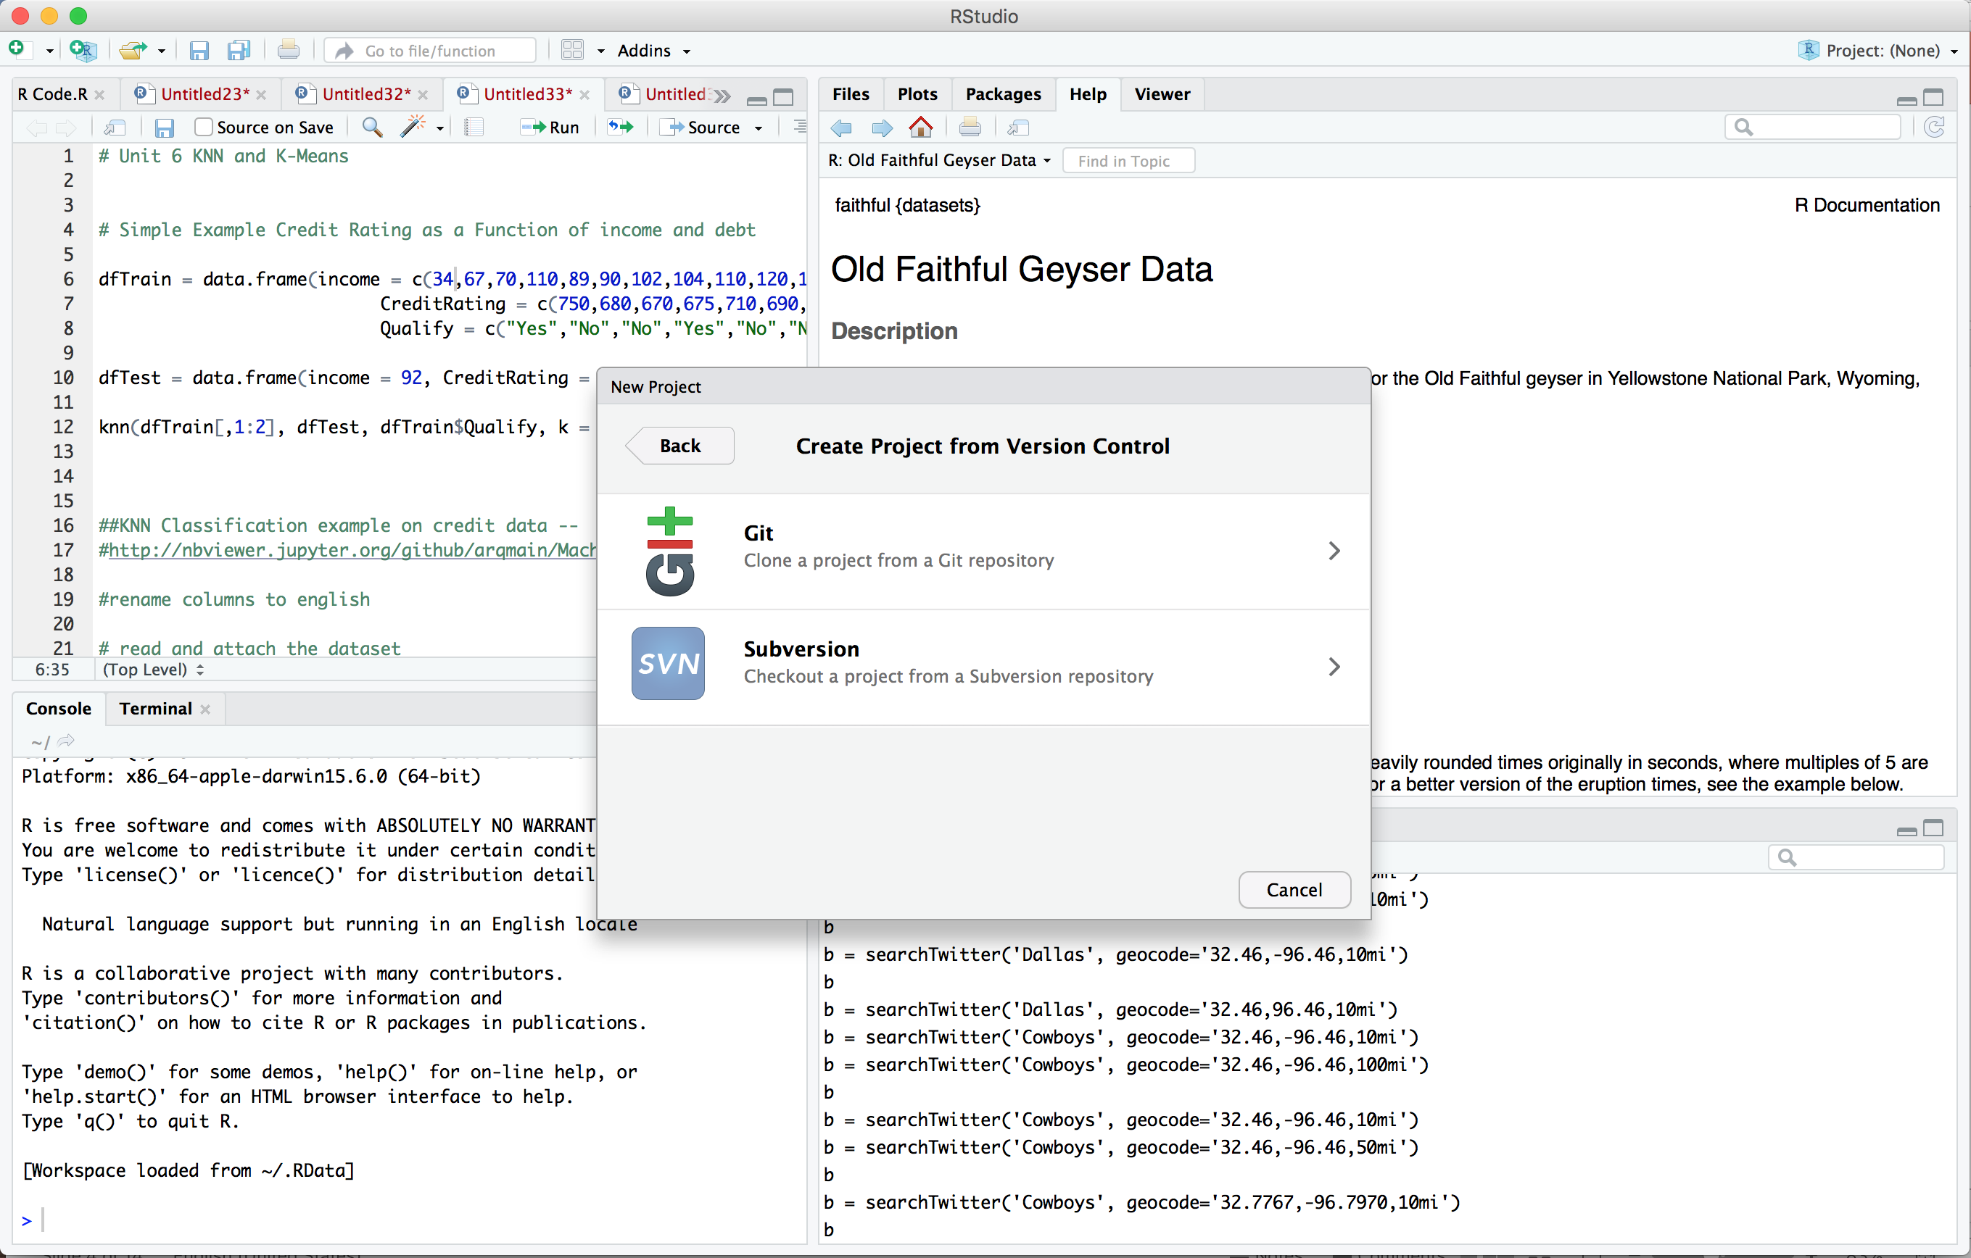
Websites with GitHub! | Simplest

Slide 20
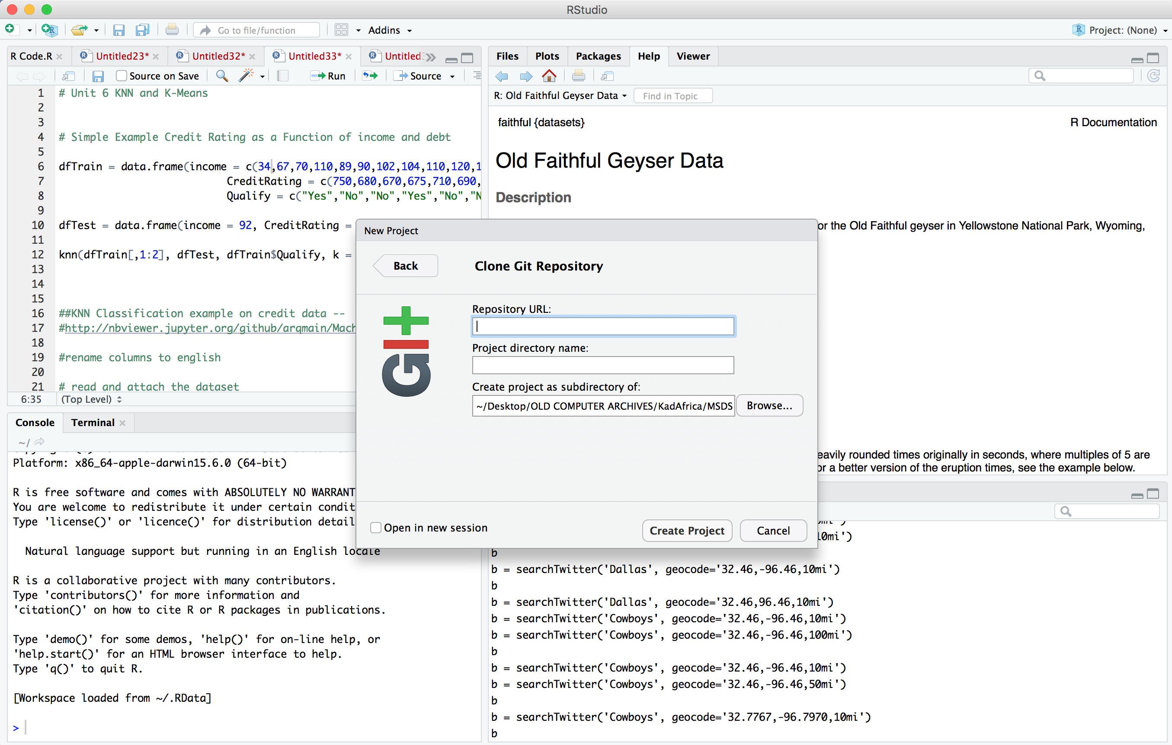
Websites with GitHub! | Simplest

Slide 21
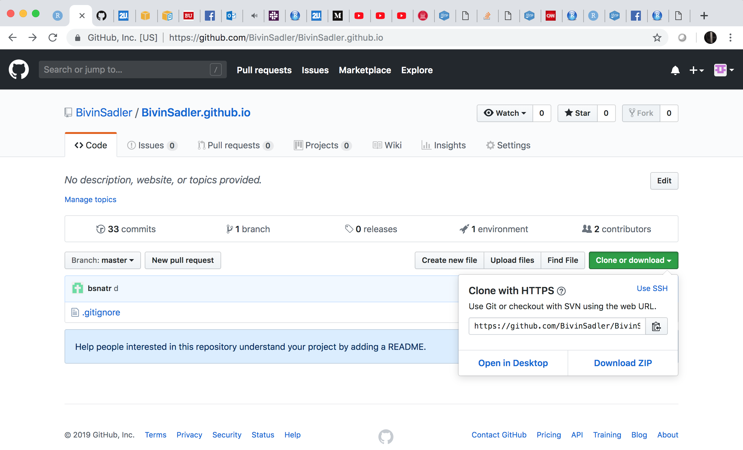
Websites with GitHub! | Simplest

Slide 22

Websites with GitHub! | Simplest

Slide 23
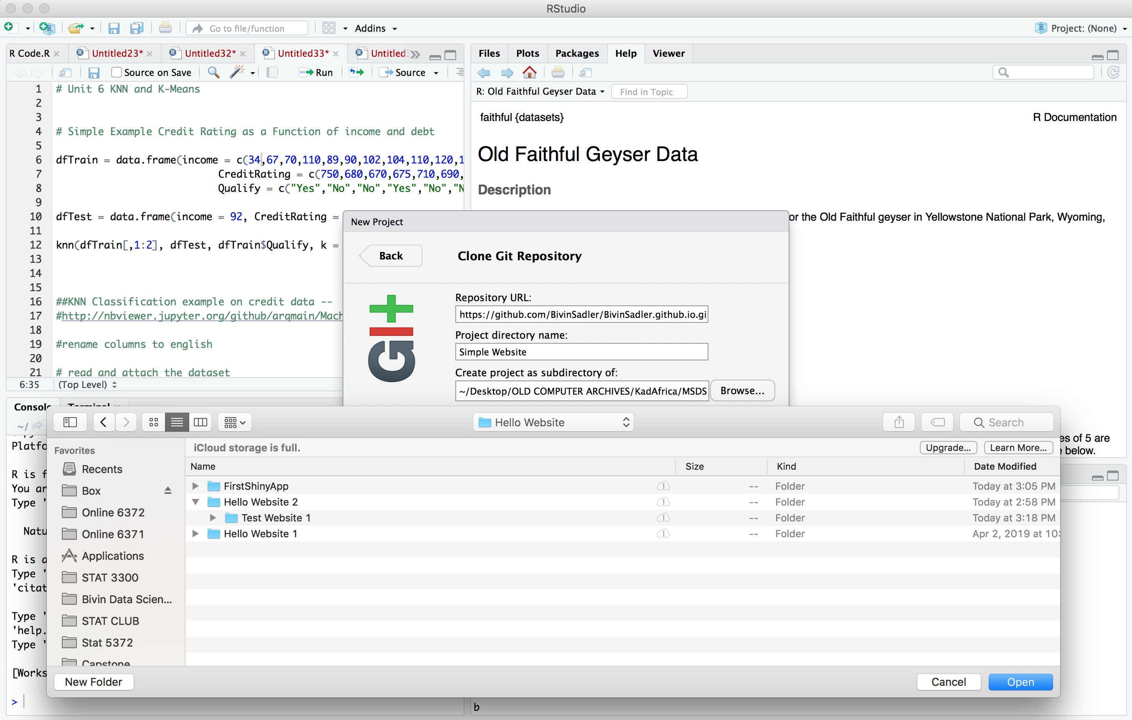
Websites with GitHub! | Simplest

Slide 24
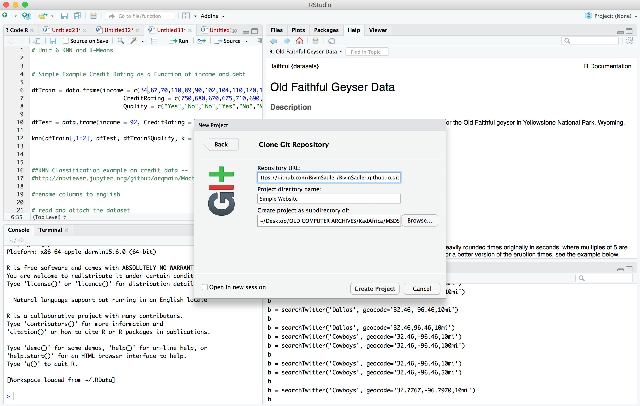

Slide 25
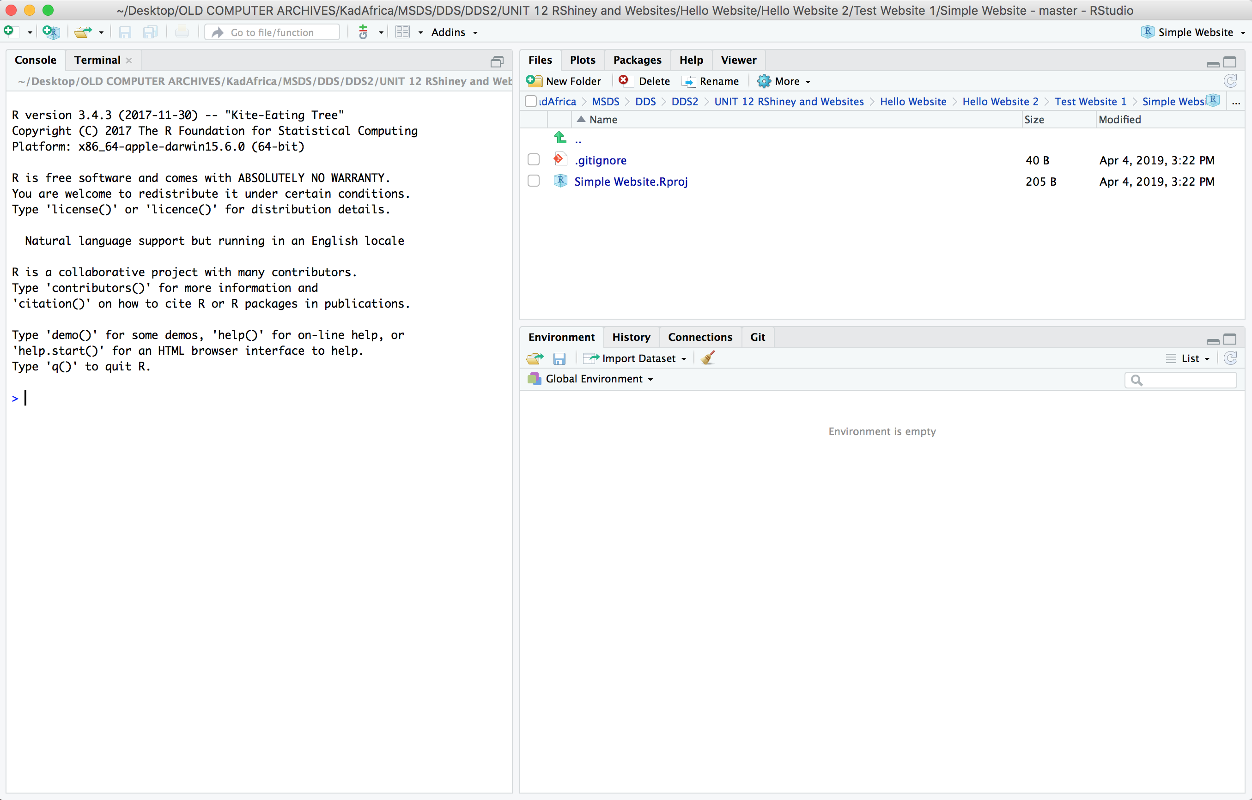
Websites with GitHub! | Simplest

Slide 26
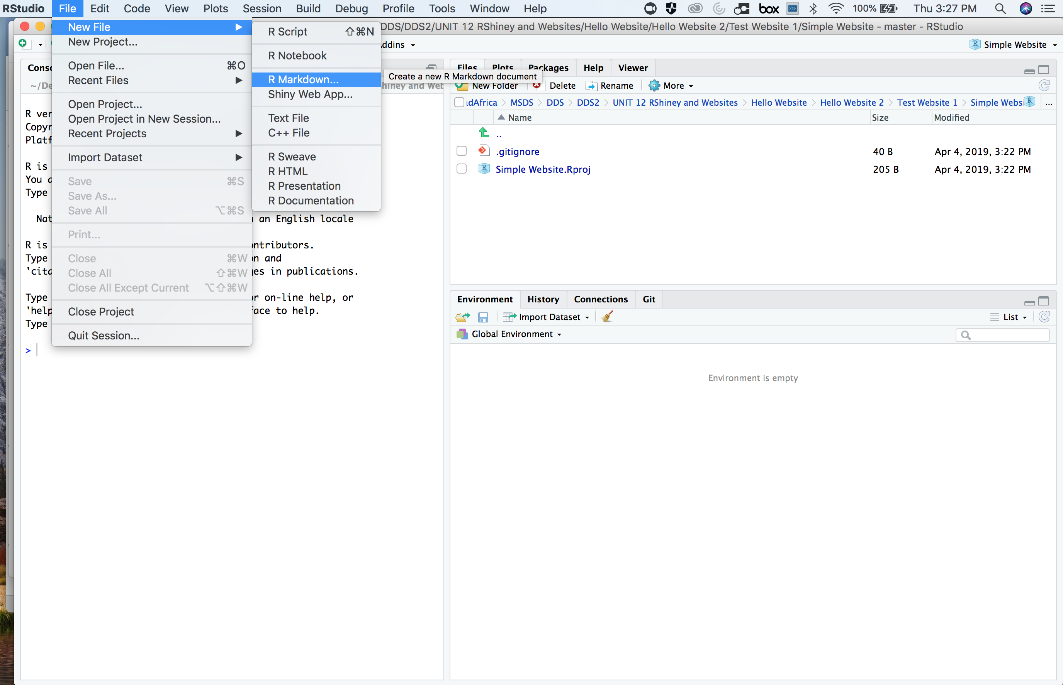
Websites with GitHub! | Simplest

Slide 27
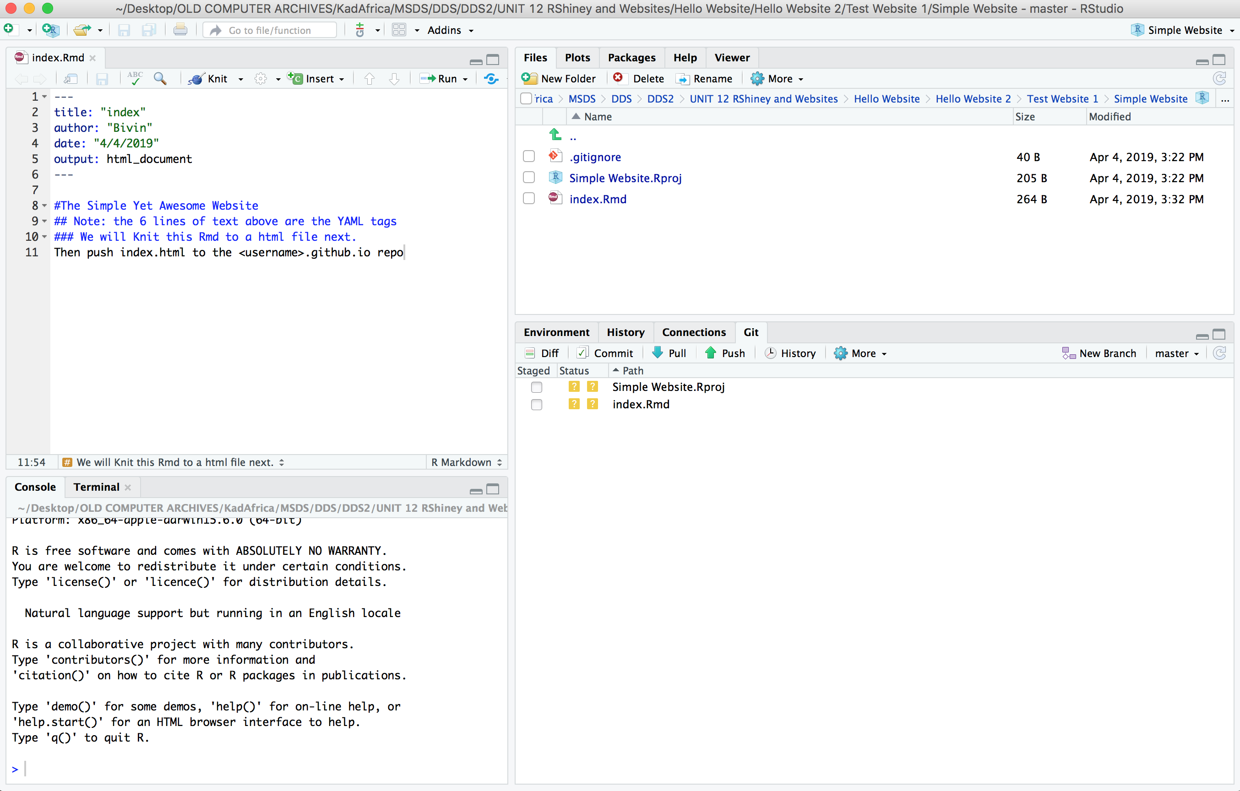
Websites with GitHub! | Simplest

Slide 28
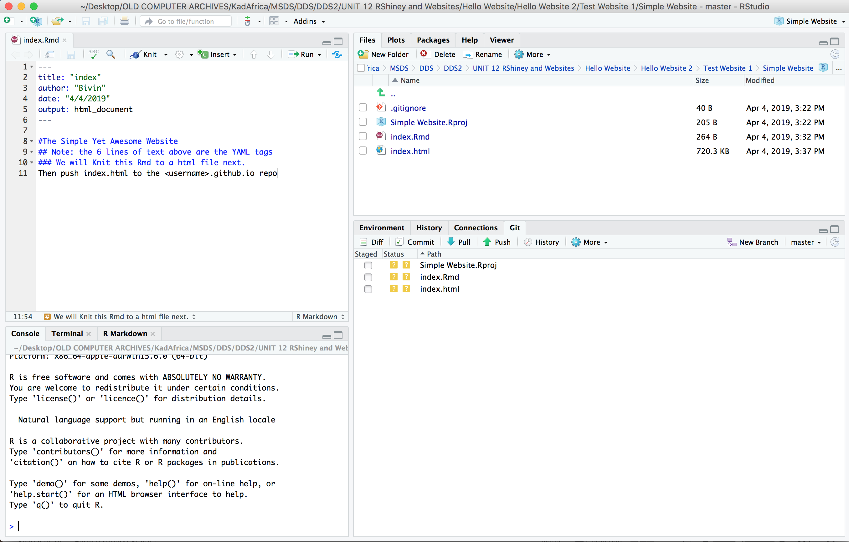
Websites with GitHub! | Simplest

Slide 29
Websites with GitHub! | Simplest

Slide 30
Websites with GitHub! | Simplest

Slide 31
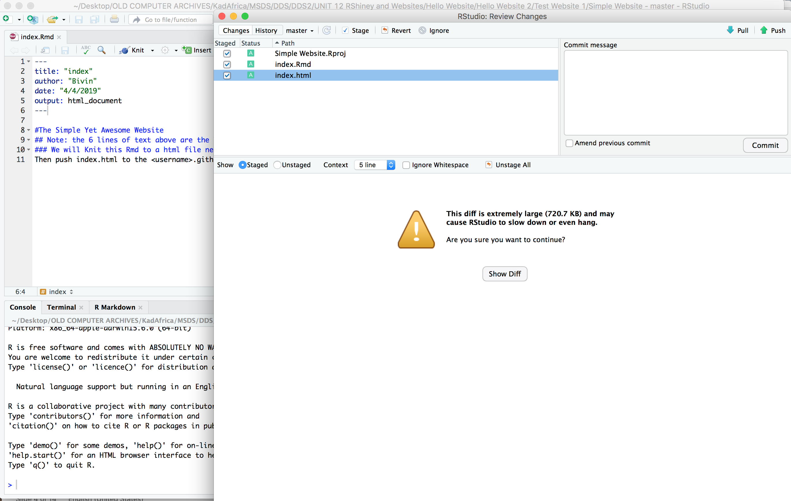
Websites with GitHub! | Simplest

Slide 32
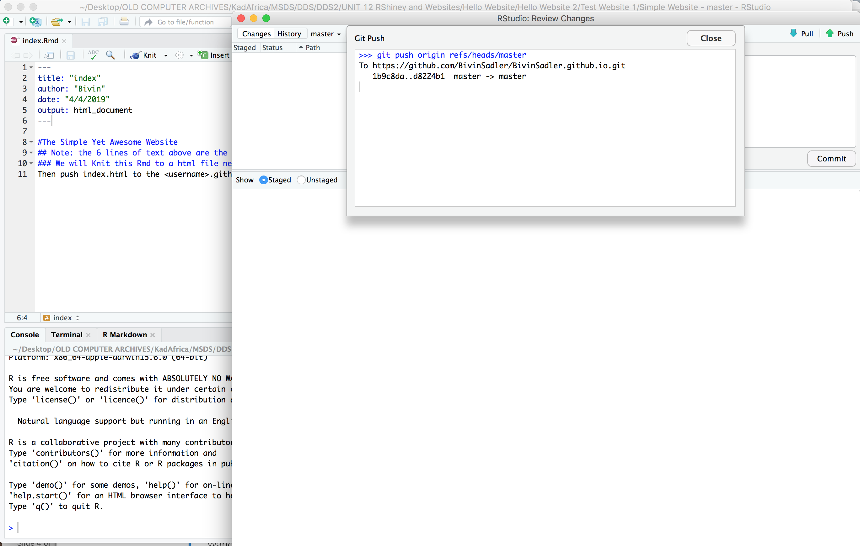
Websites with GitHub! | Simplest

Slide 33
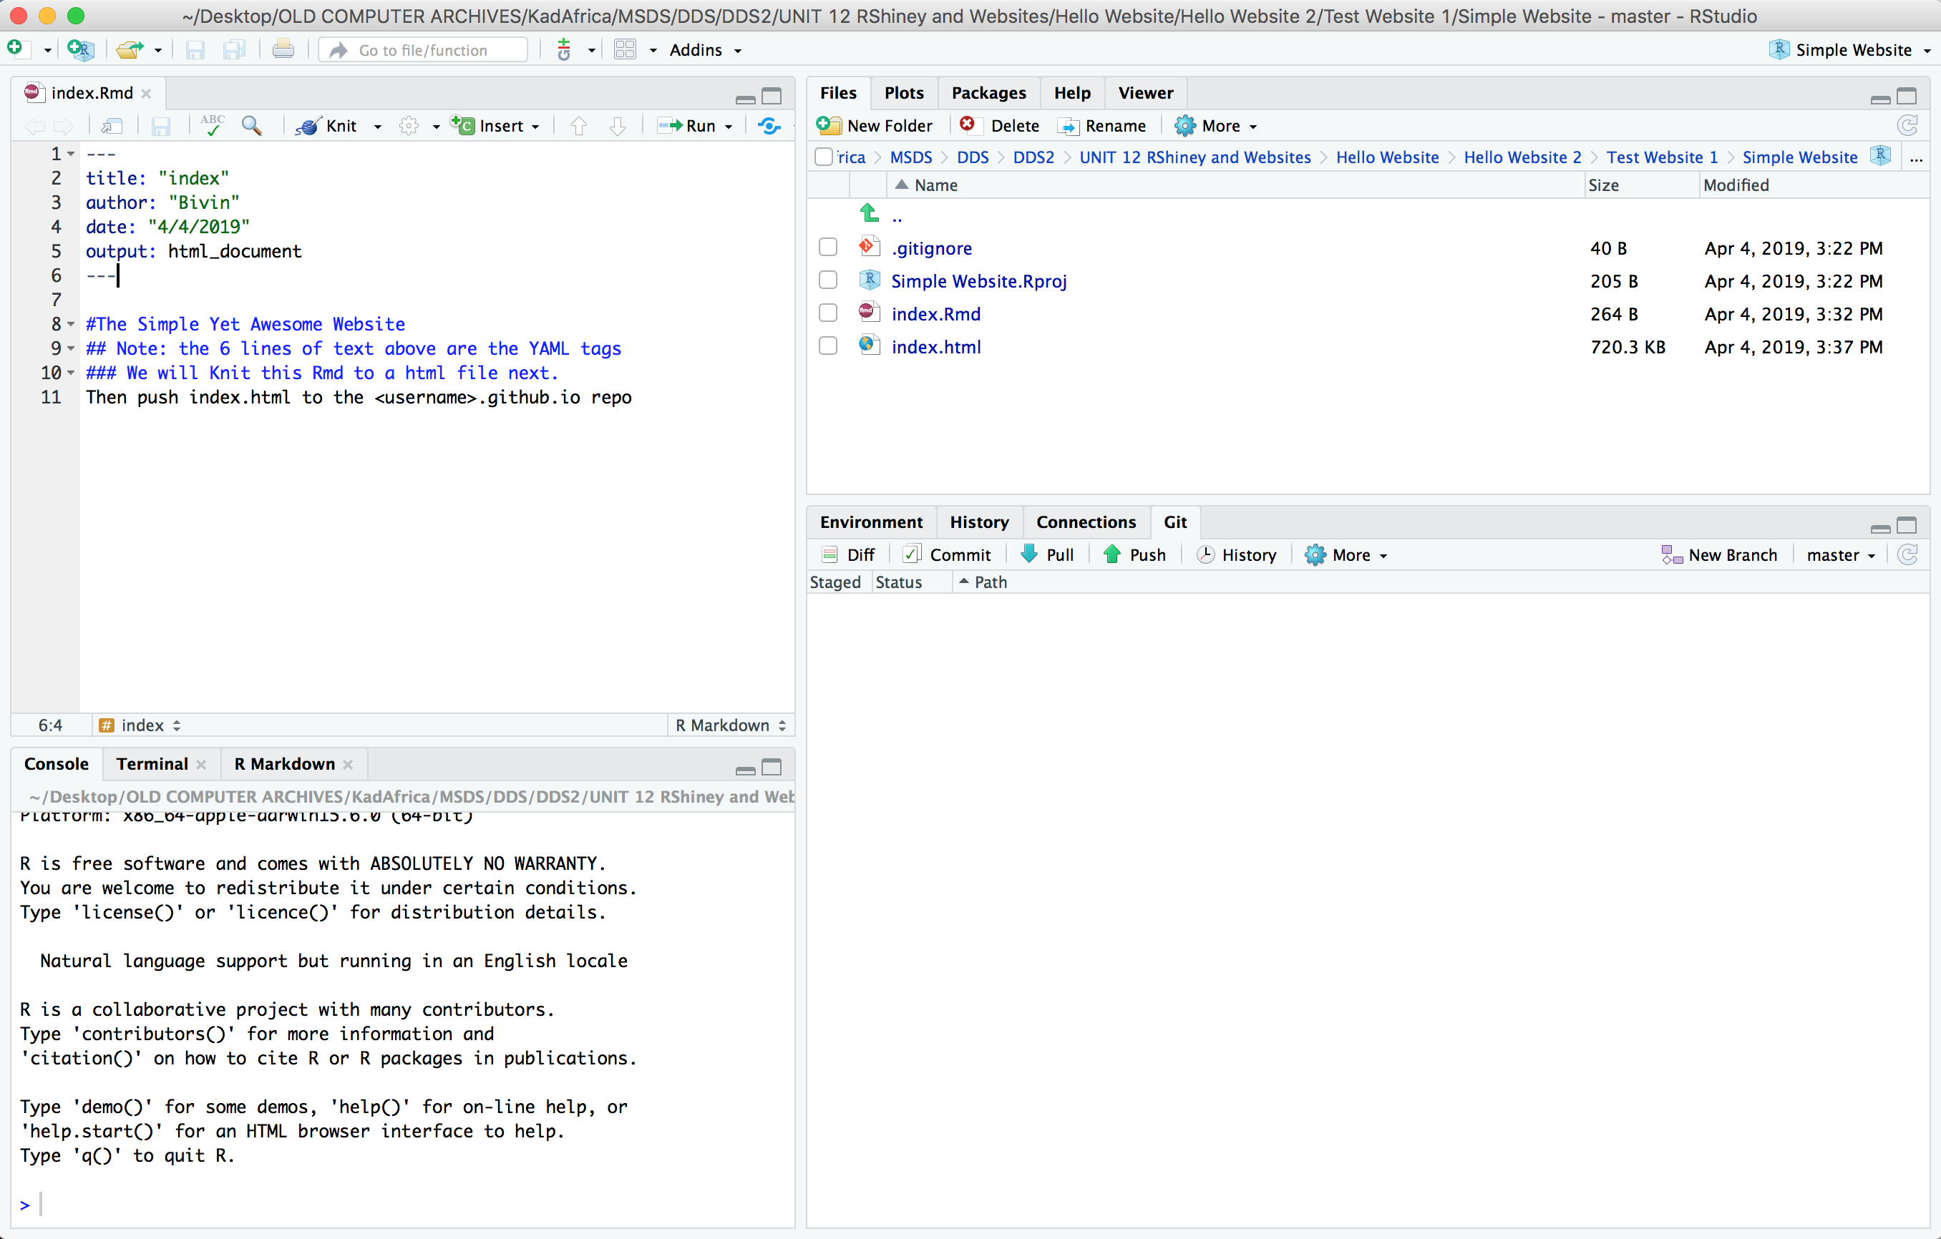
Websites with GitHub! | Simplest

Slide 34
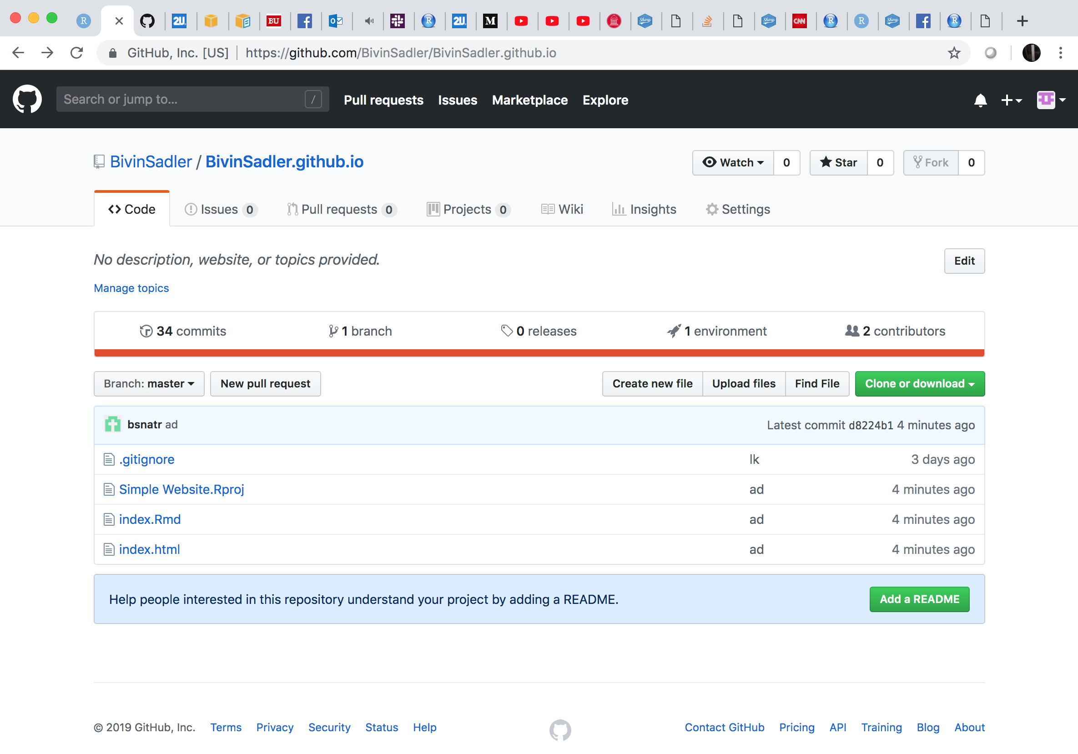
Websites with GitHub! | Simplest

Slide 35
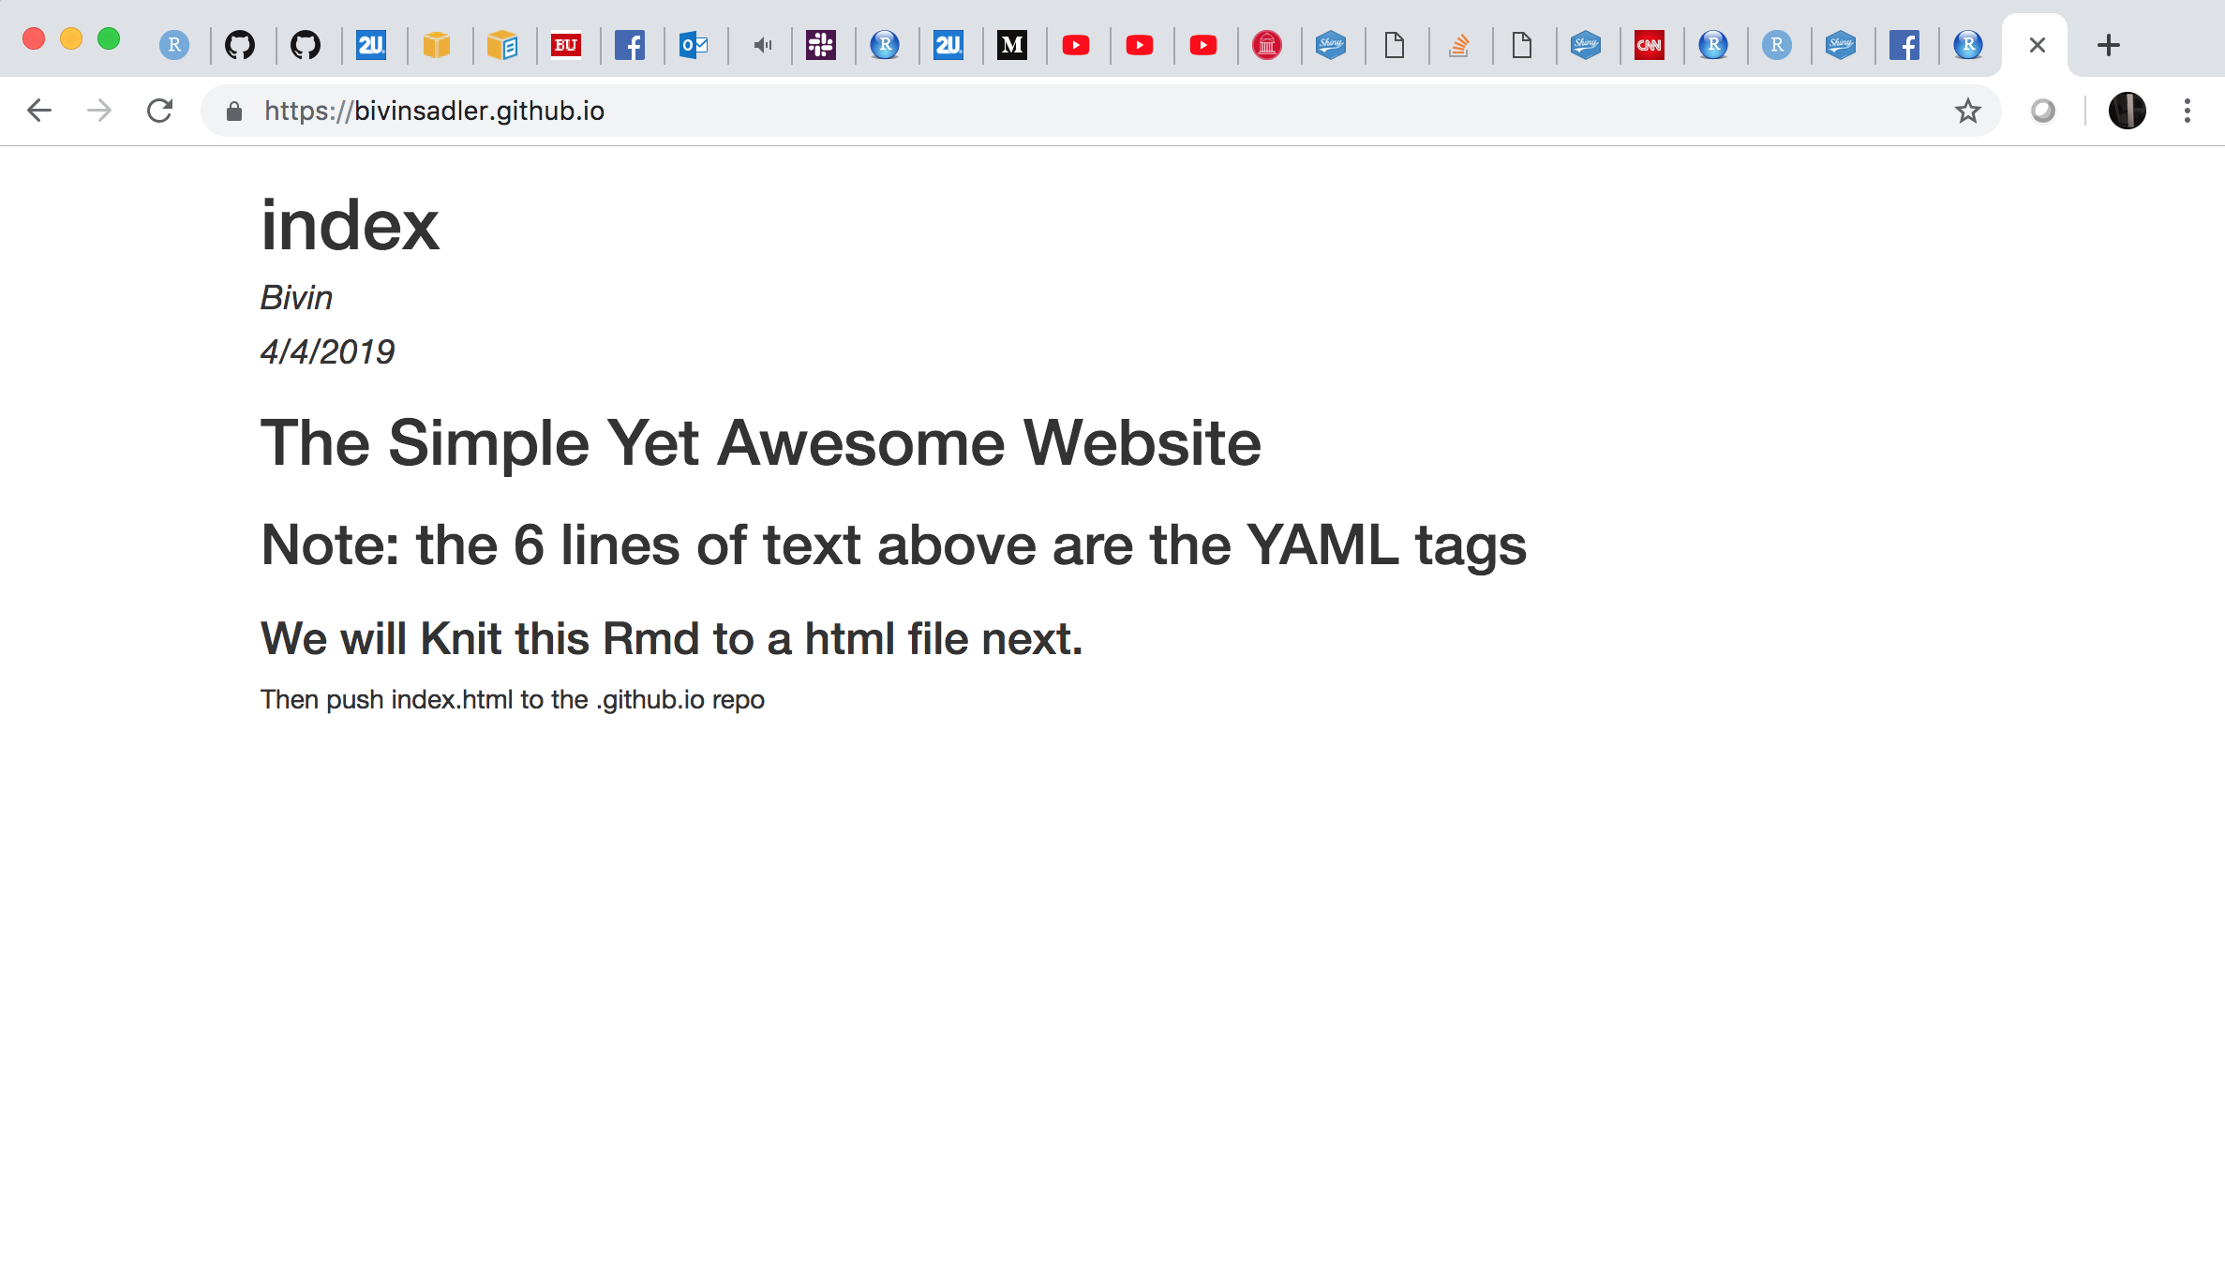
Websites with GitHub! | Simplest

Slide 36
Summary: Websites with GitHub!
Create a repository by the name of <username>.github.io
Clone the repository to a directory in RStudio
Create index.Rmd
Knit index.Rmd
Commit changes in the Git tab
Push changes in the Git tab
Checkout your website at http://<username>.github.io

Slide 38
Example 2: Adding R Markdown Pages and YAML

Slide 39
Summary: Websites with GitHub!
Create a repository by the name of <username>.github.io
Clone the repository to a directory in RStudio
Create index.Rmd
Knit index.Rmd
Commit changes in the Git tab
Push changes in the Git tab
Checkout your website at http://<username>.github.io
Here we are! We would now like to use YAML and Rmarkdown to add more information and make it look nice!

Slide 40
Websites with GitHub! | Simple

Slide 41
Websites with GitHub! | Simple

Slide 42
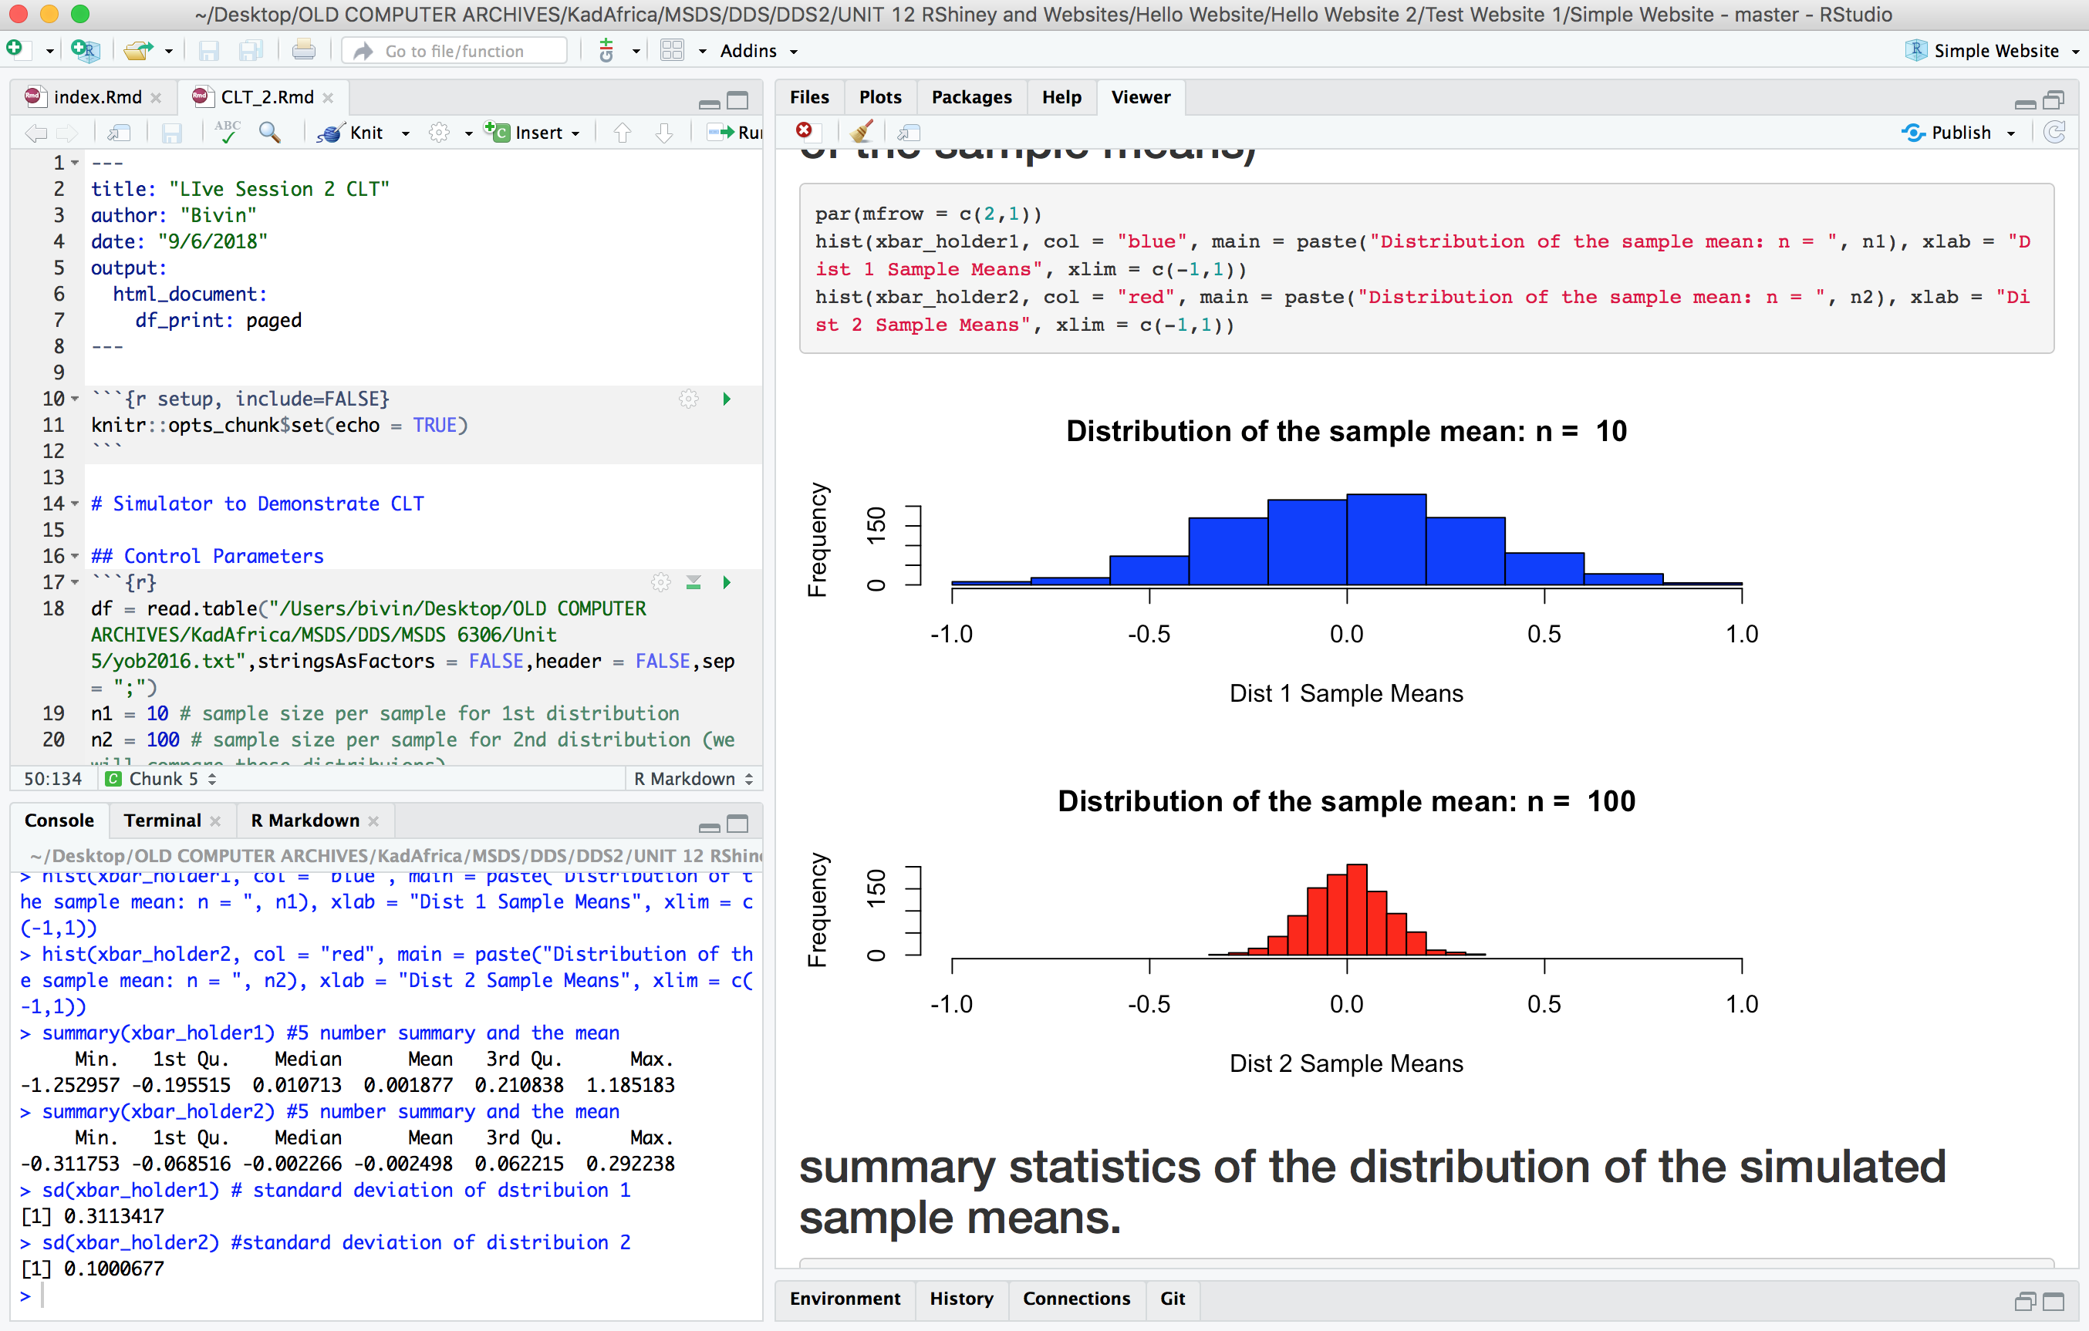
Websites with GitHub! | Simple

Slide 43
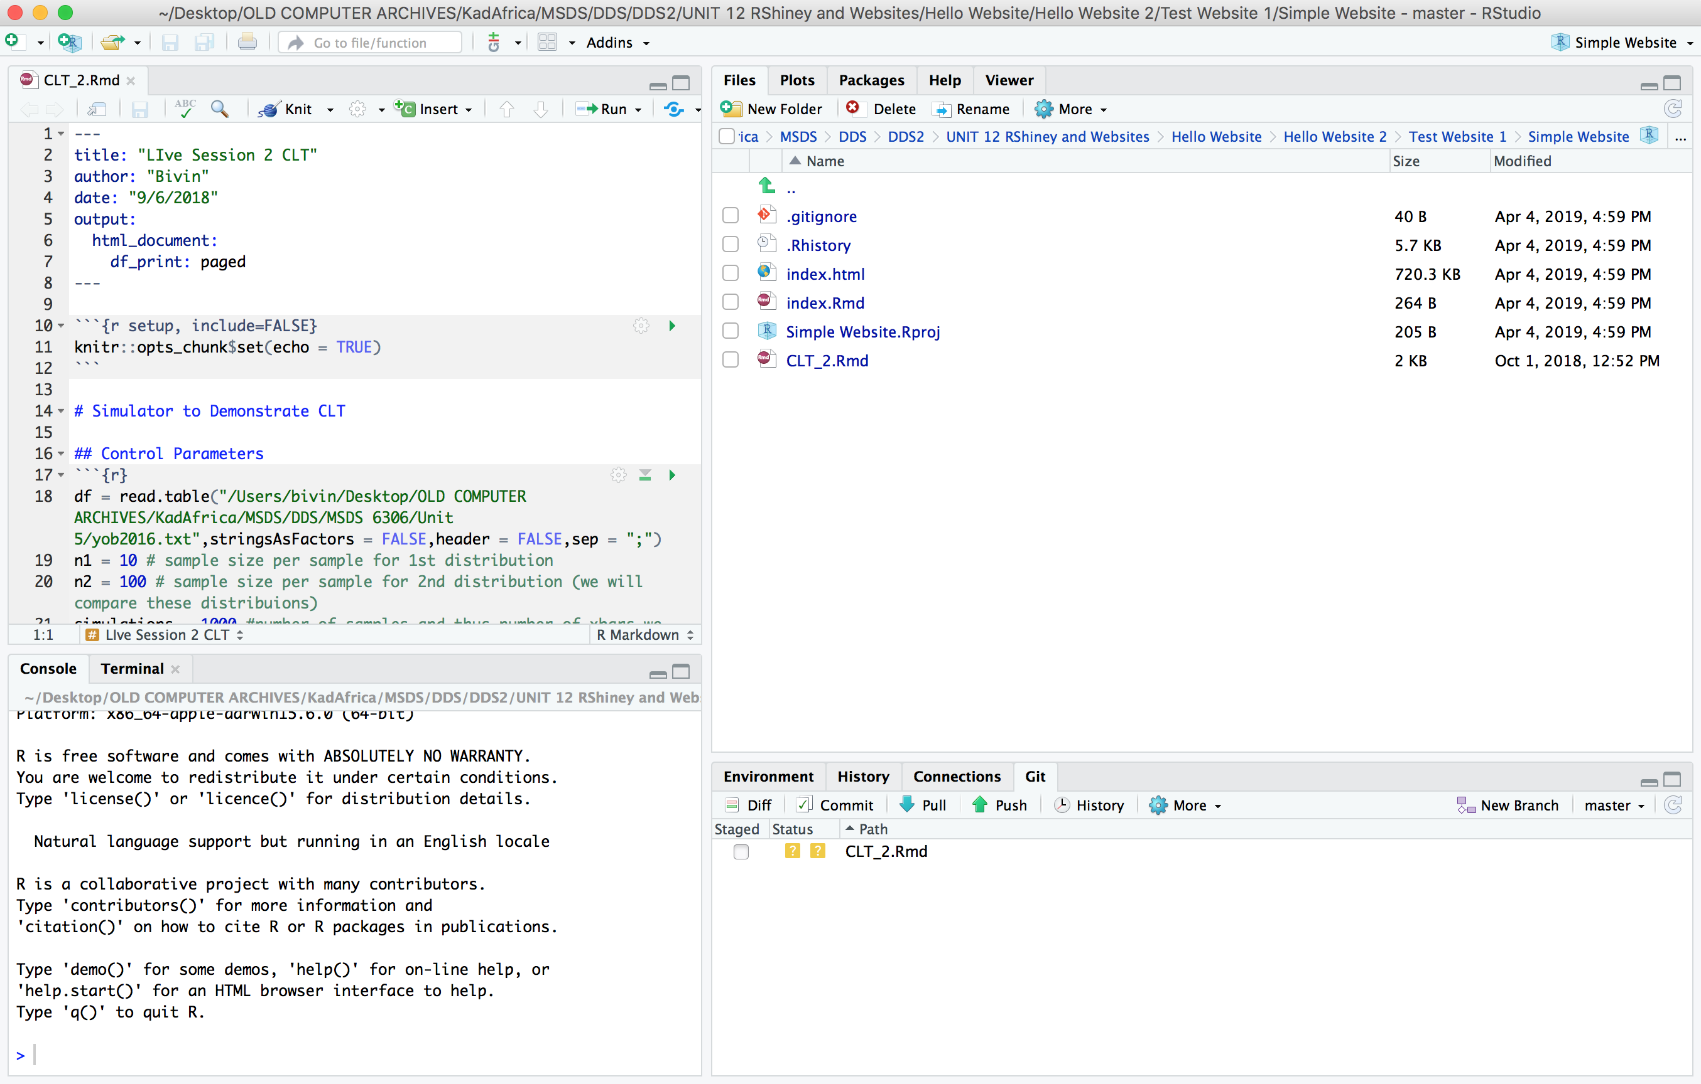
Websites with GitHub! | Simple

Slide 44
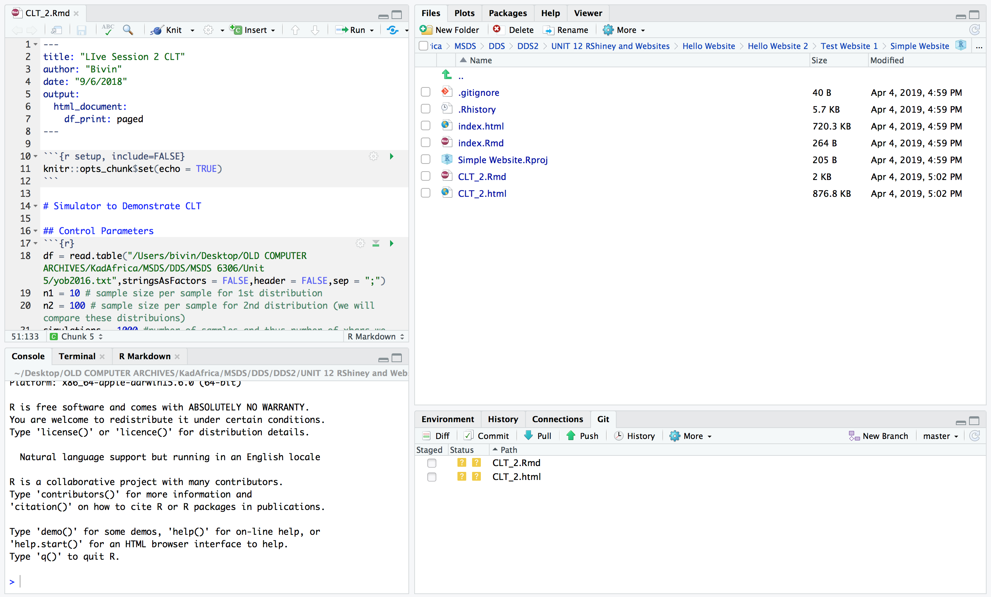
Websites with GitHub! | Simple

Slide 45
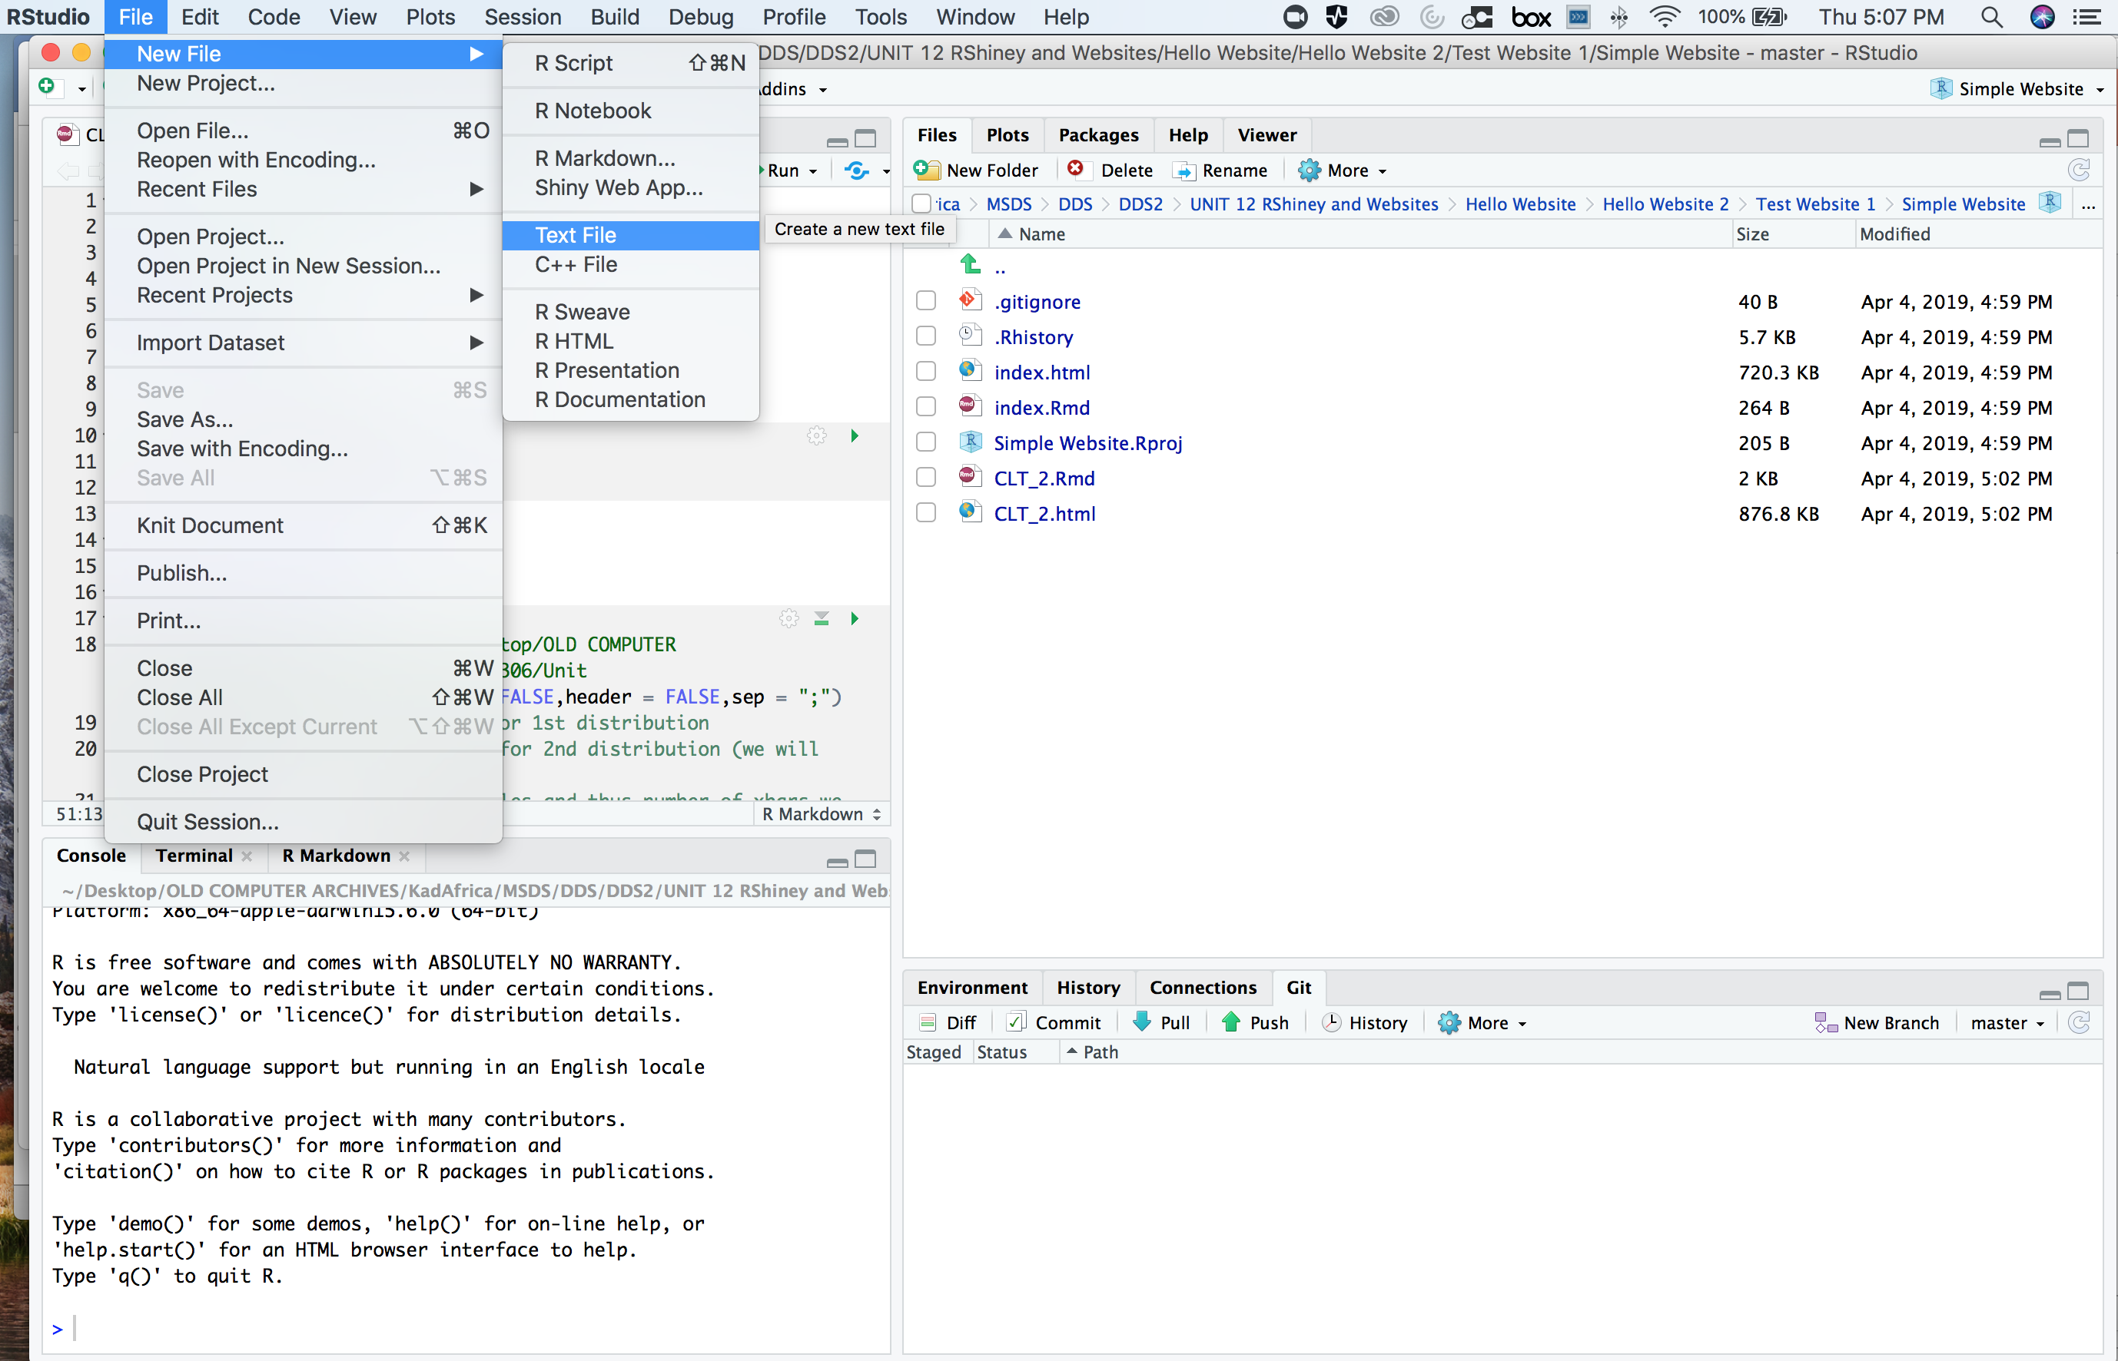
Websites with GitHub! | Simple

Slide 46
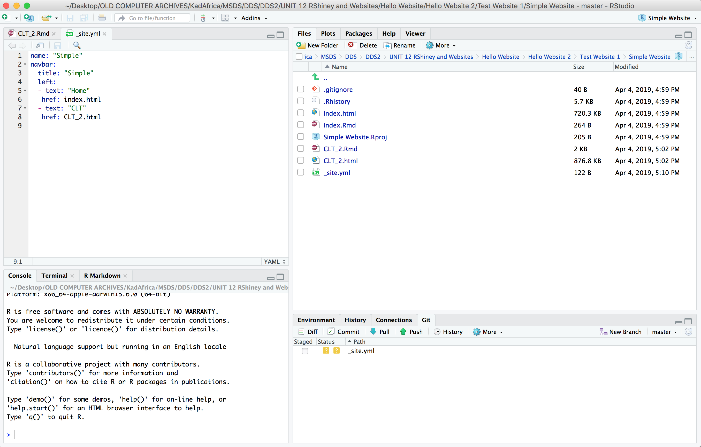
Websites with GitHub! | Simple

Slide 47
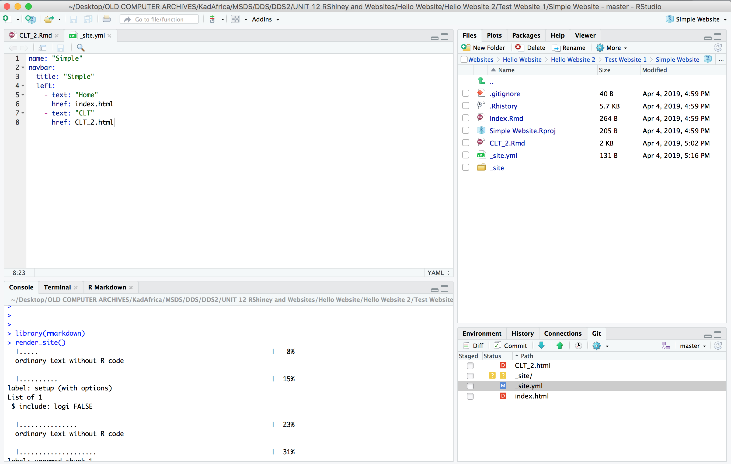
Websites with GitHub! | Simple

Slide 48
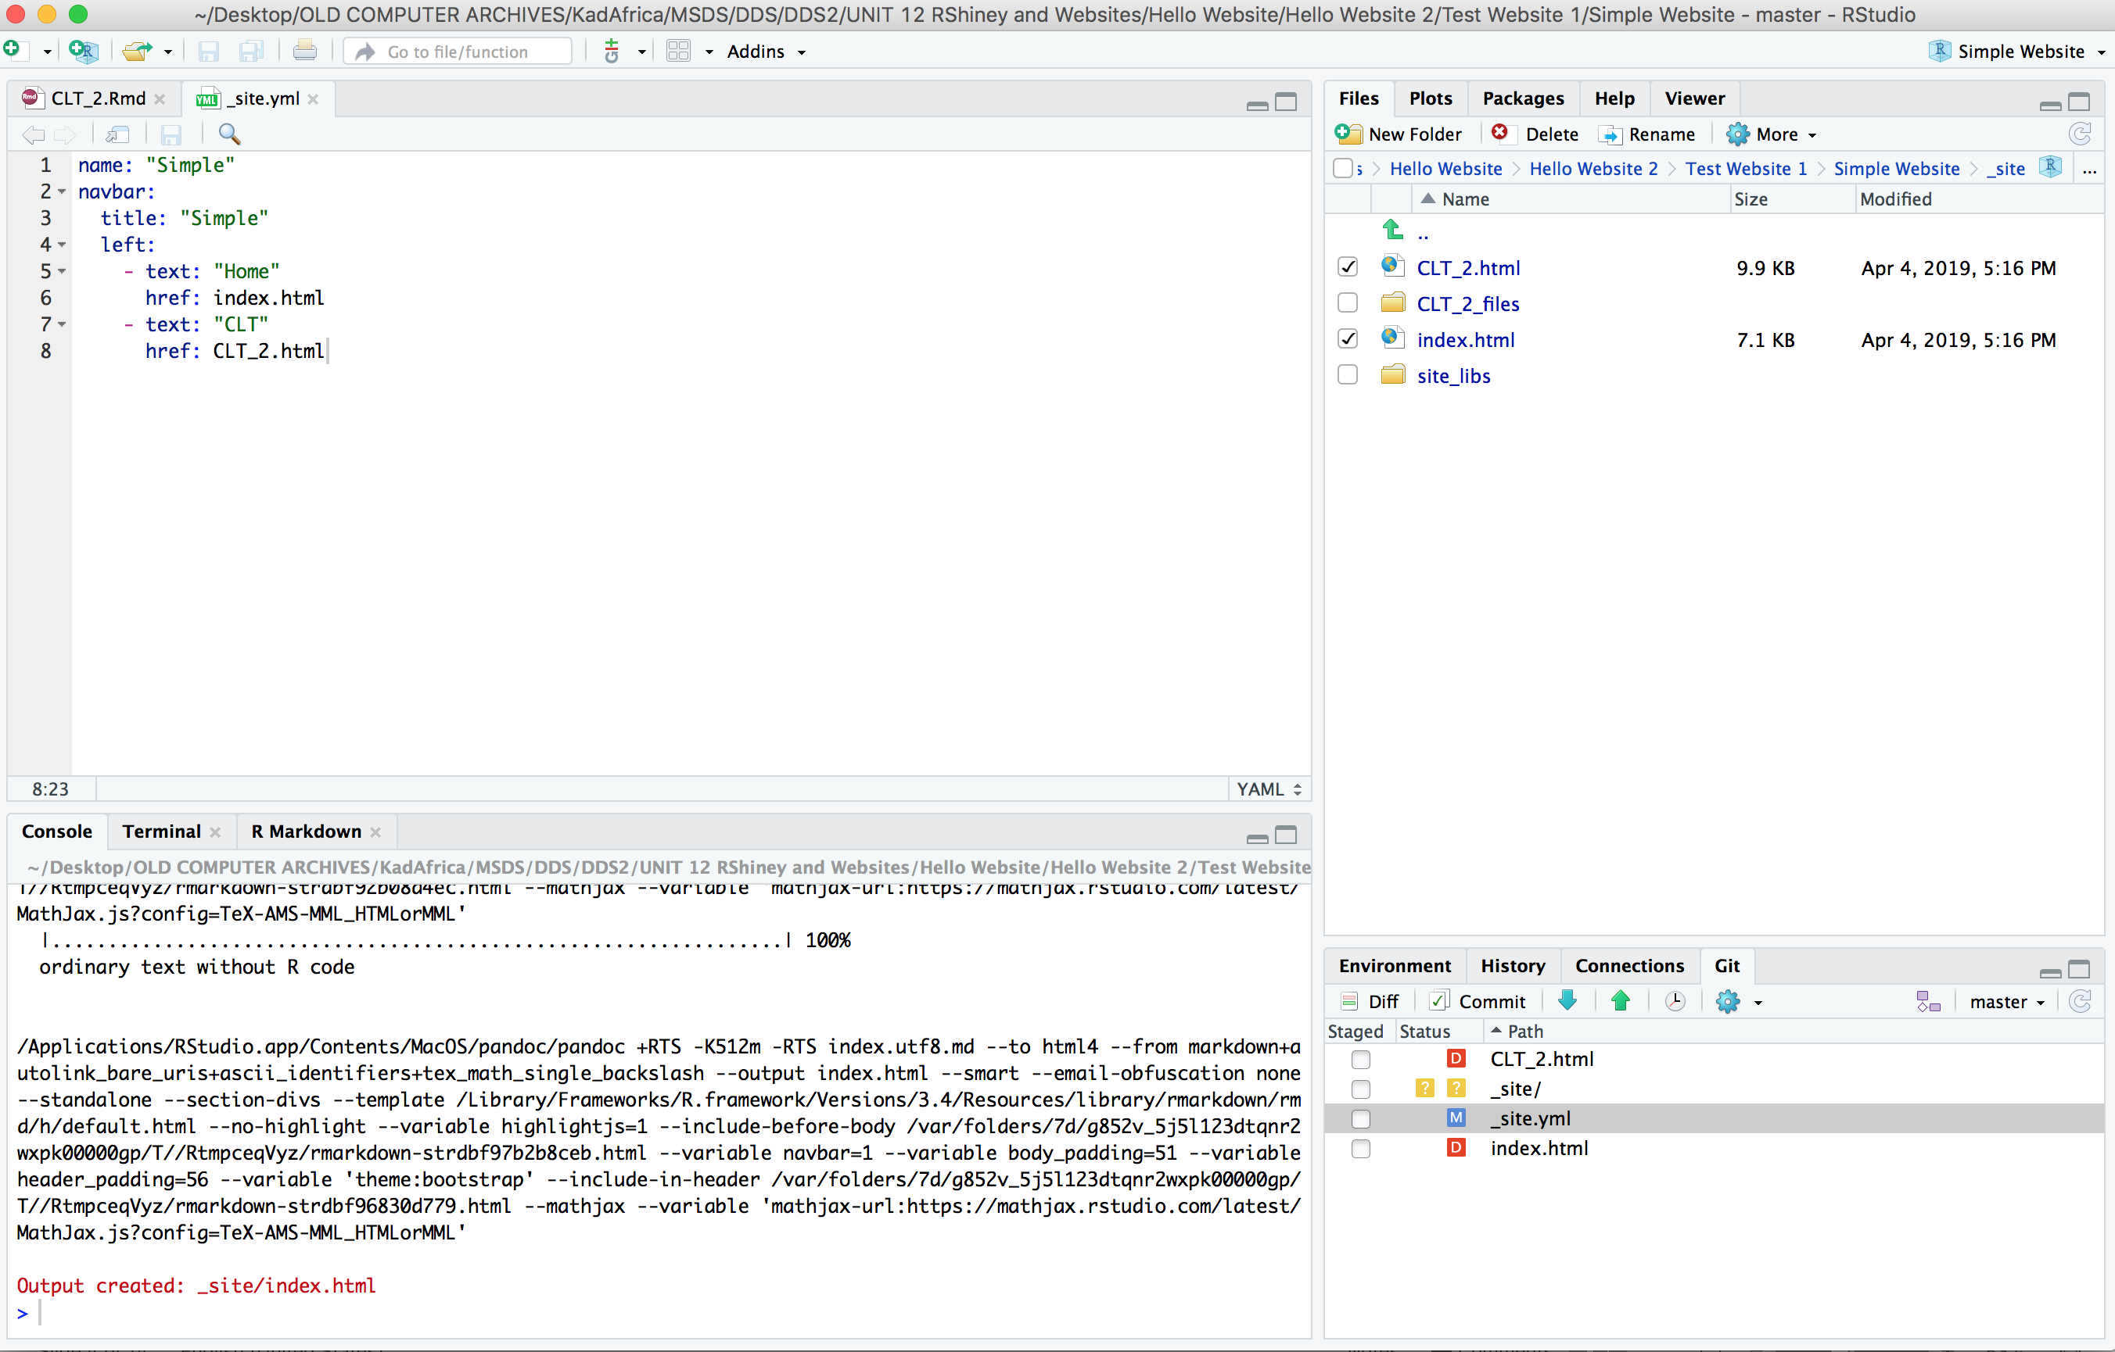

Websites with GitHub! | Simple

Slide 49
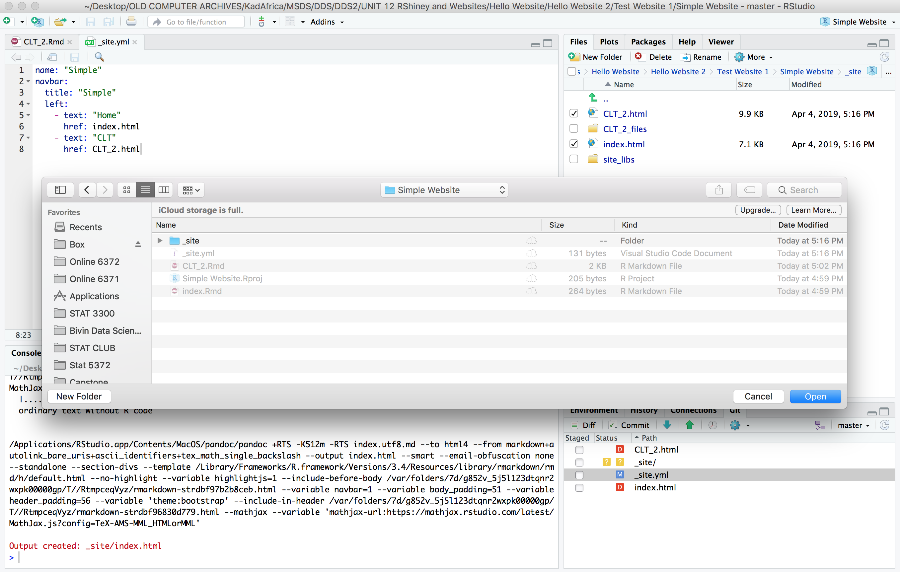

Websites with GitHub! | Simple

Slide 50
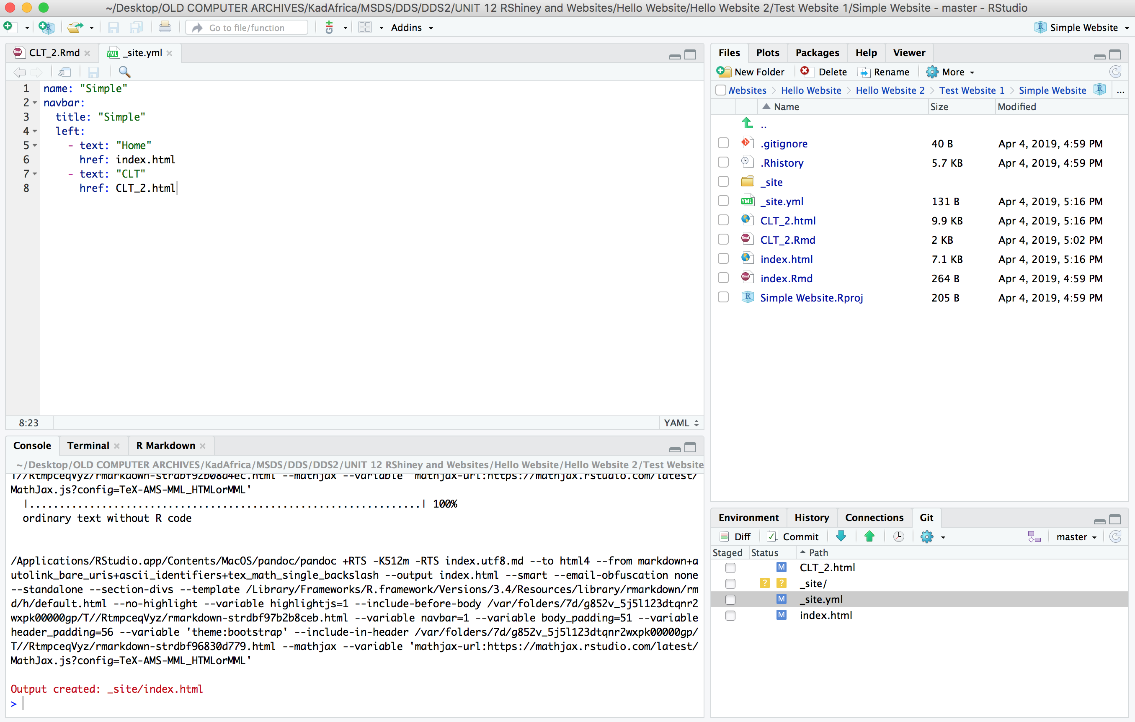
Websites with GitHub! | Simple

Slide 51
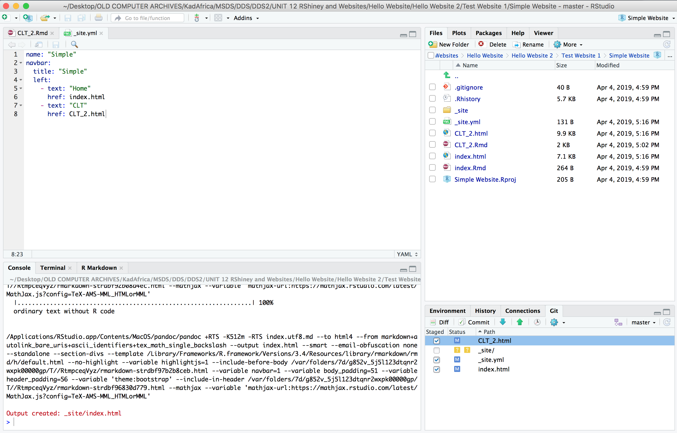
Websites with GitHub! | Simple

Slide 52
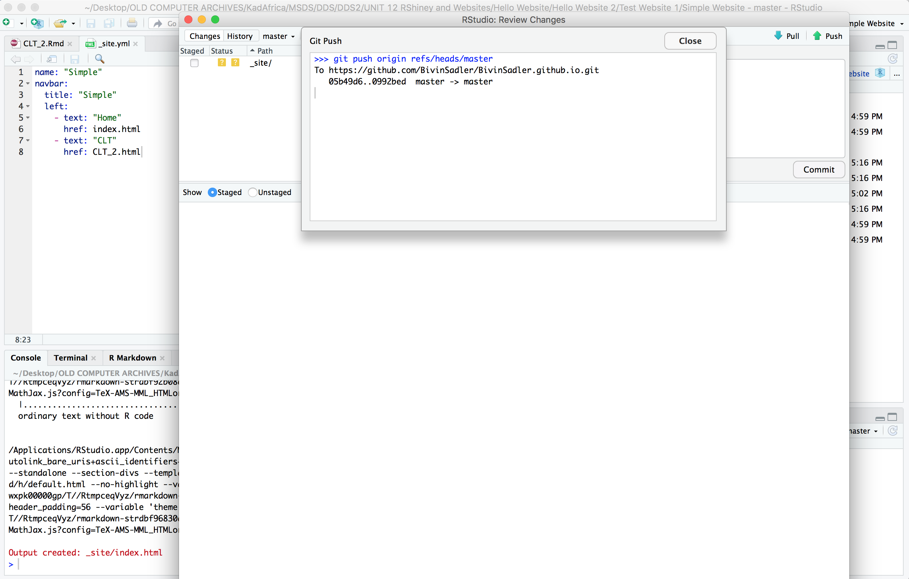
Websites with GitHub! | Simple

Slide 53
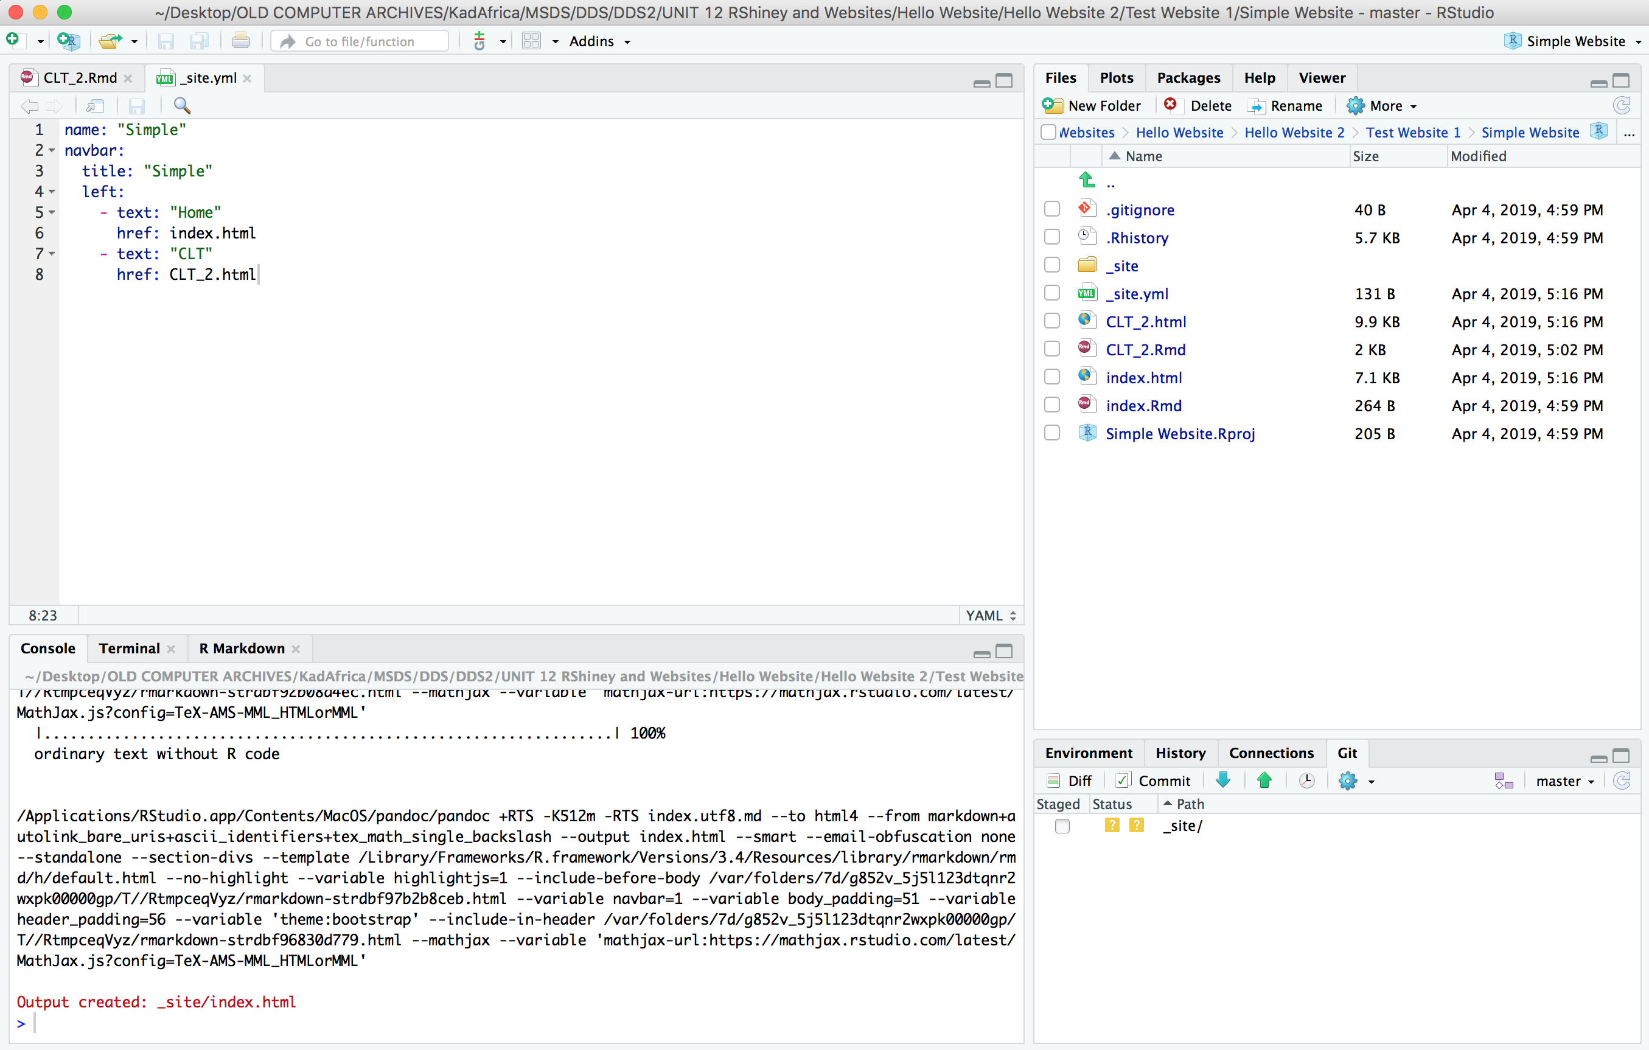
Websites with GitHub! | Simple

Slide 54
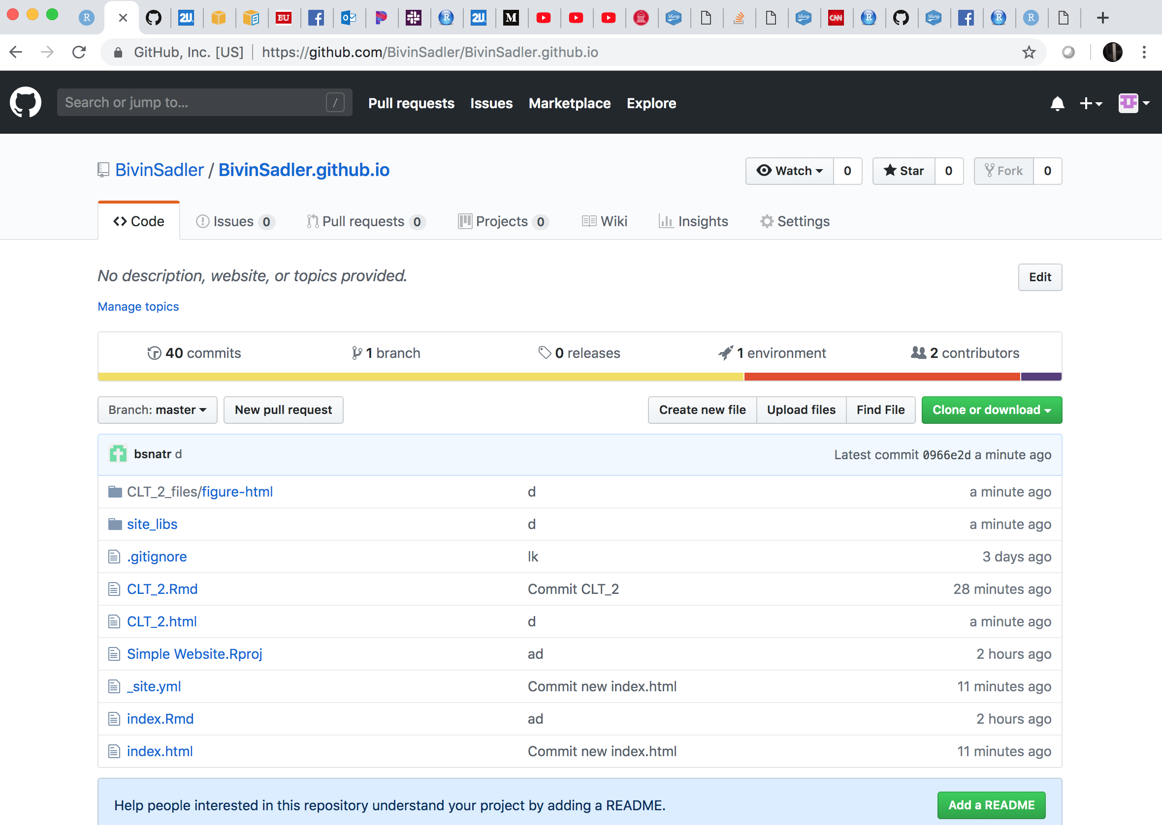
Websites with GitHub! | Simple

Slide 55
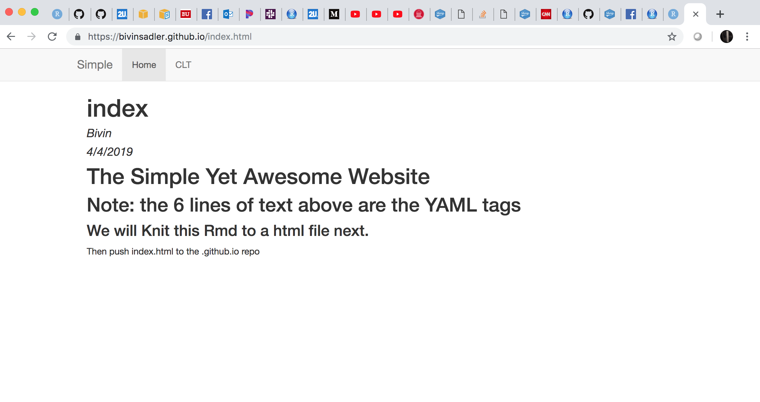
Websites with GitHub! | Simple

Slide 56
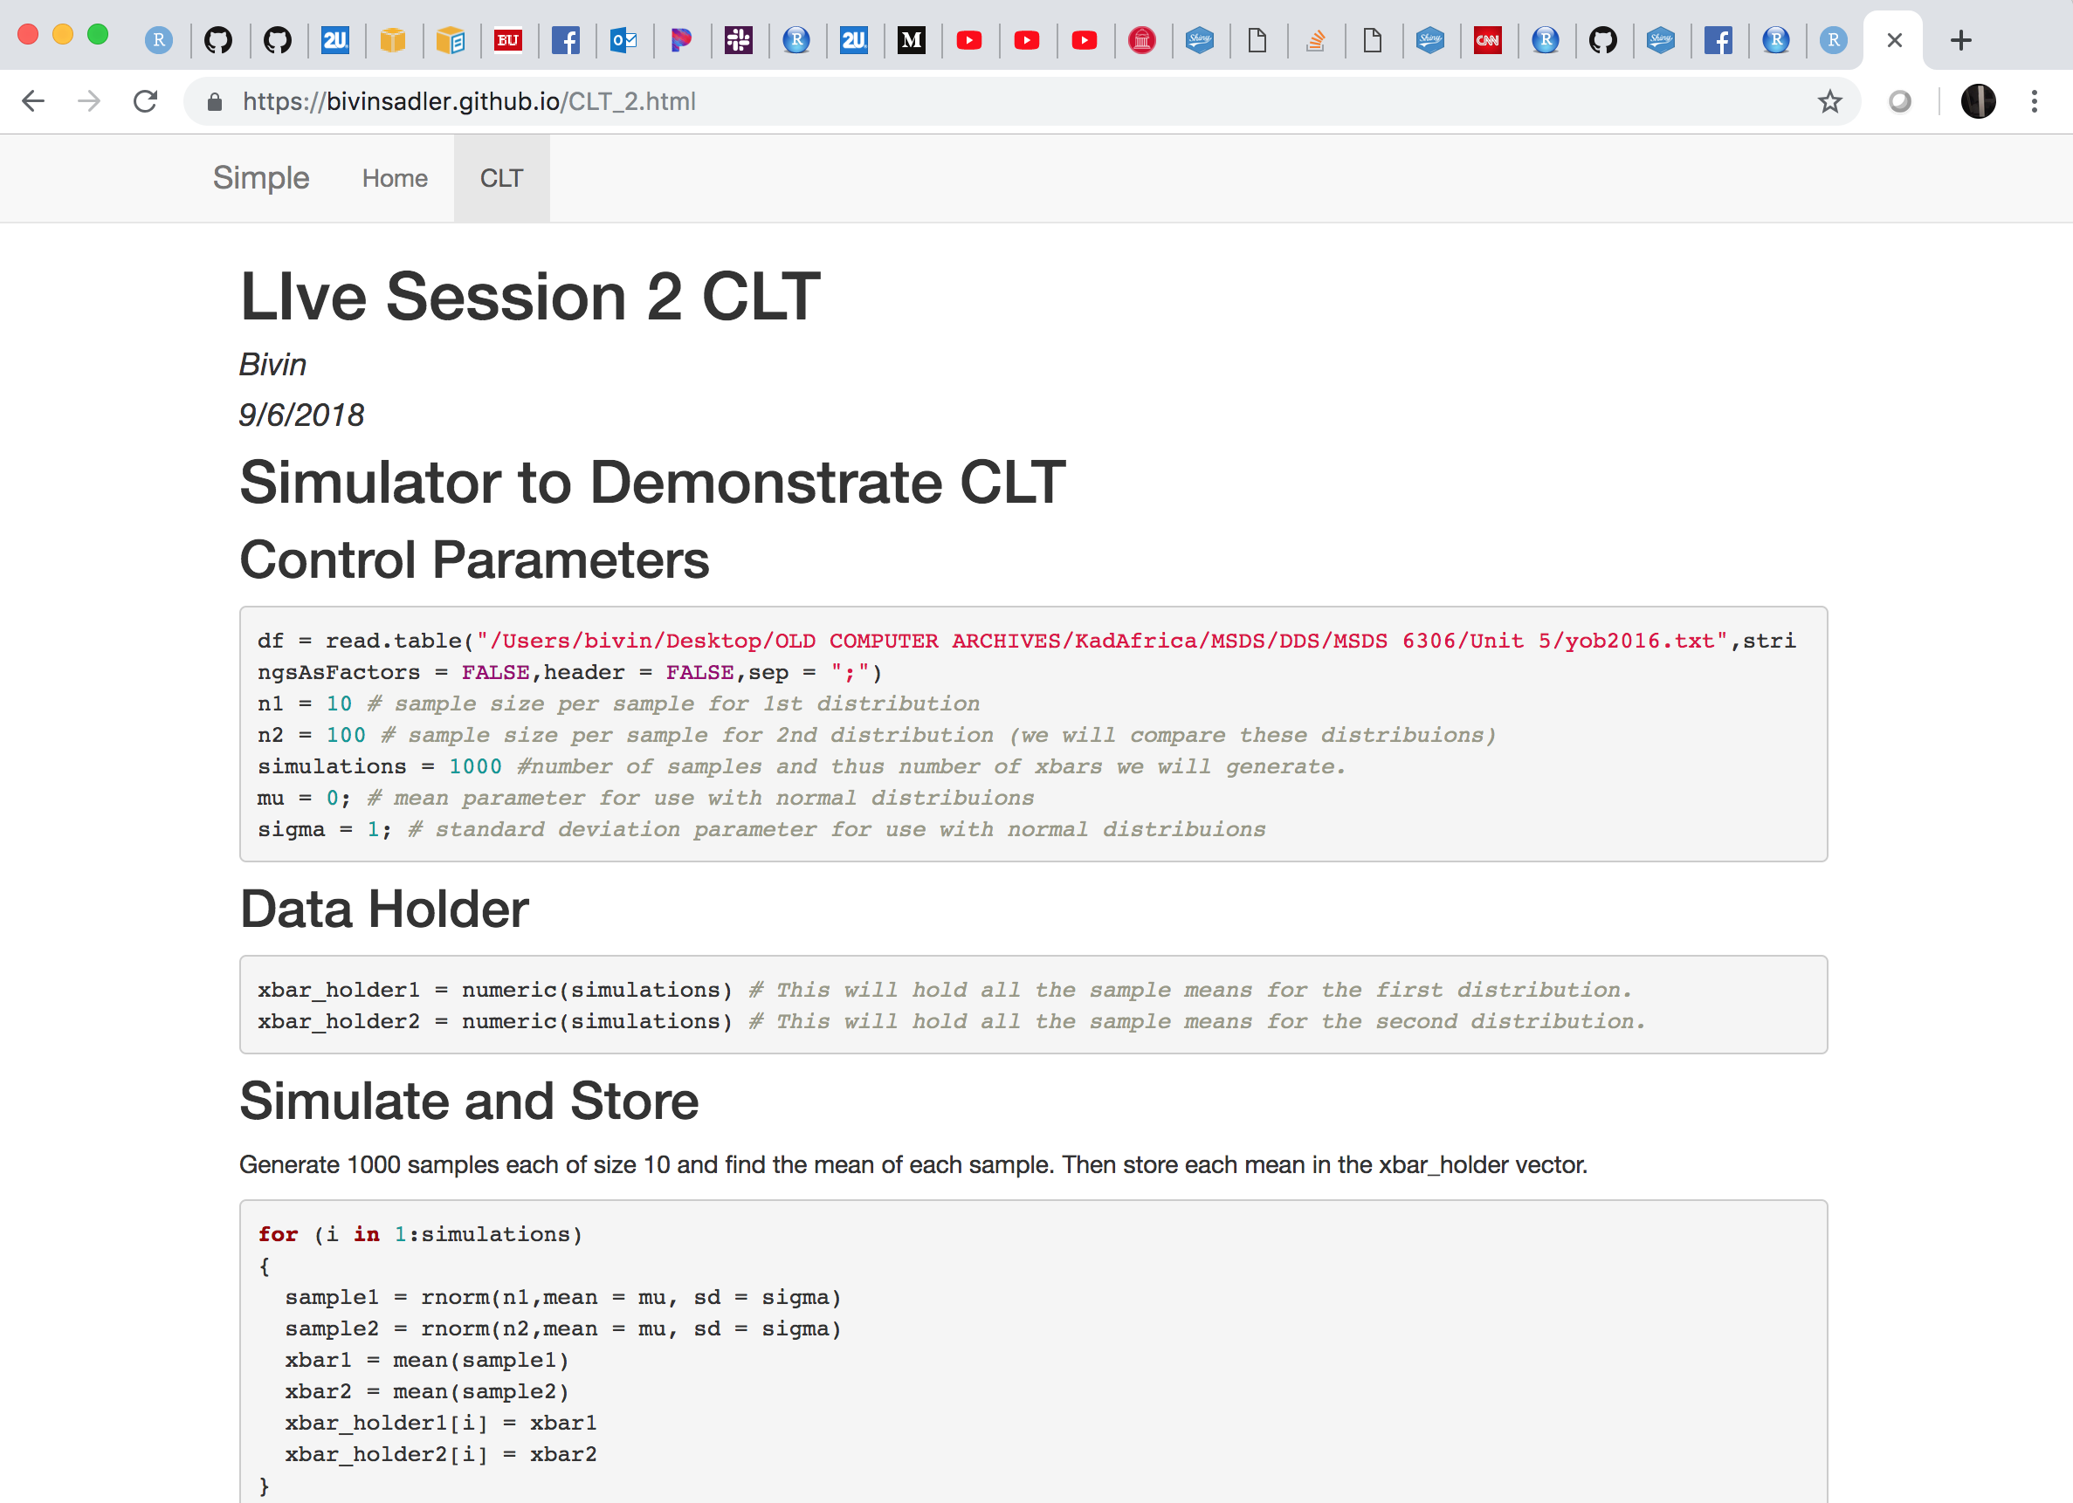
Websites with GitHub! | Simple

Slide 57
Websites with GitHub!
Files you need in root GitHub directory:
index.html
any other html docs from knitting Rmarkdown
_site.yml
Note: Shiny Files can be in Rmarkdown documents but can’t be included in Github Pages websites.
Flow
Create a repository by the name of <username>.github.io
Clone the repository to a directory in RStudio
Create index.Rmd
Knit index.Rmd
Commit changes in the Git tab
Push changes in the Git tab
make all other Rmds
knit each Rmd to make html documents
make _site.yml (these are the instructions to combine all the html files into a nice looking website)
use package rmarkdown::render_site() to make/update _site directory
copy all contents of _site directory to the root directory of project
commit changes
Push Changes to GitHub
Check out your website!

Slide 59
Example 3: Adding RShiny Apps to GitHub Page Websites

Slide 60
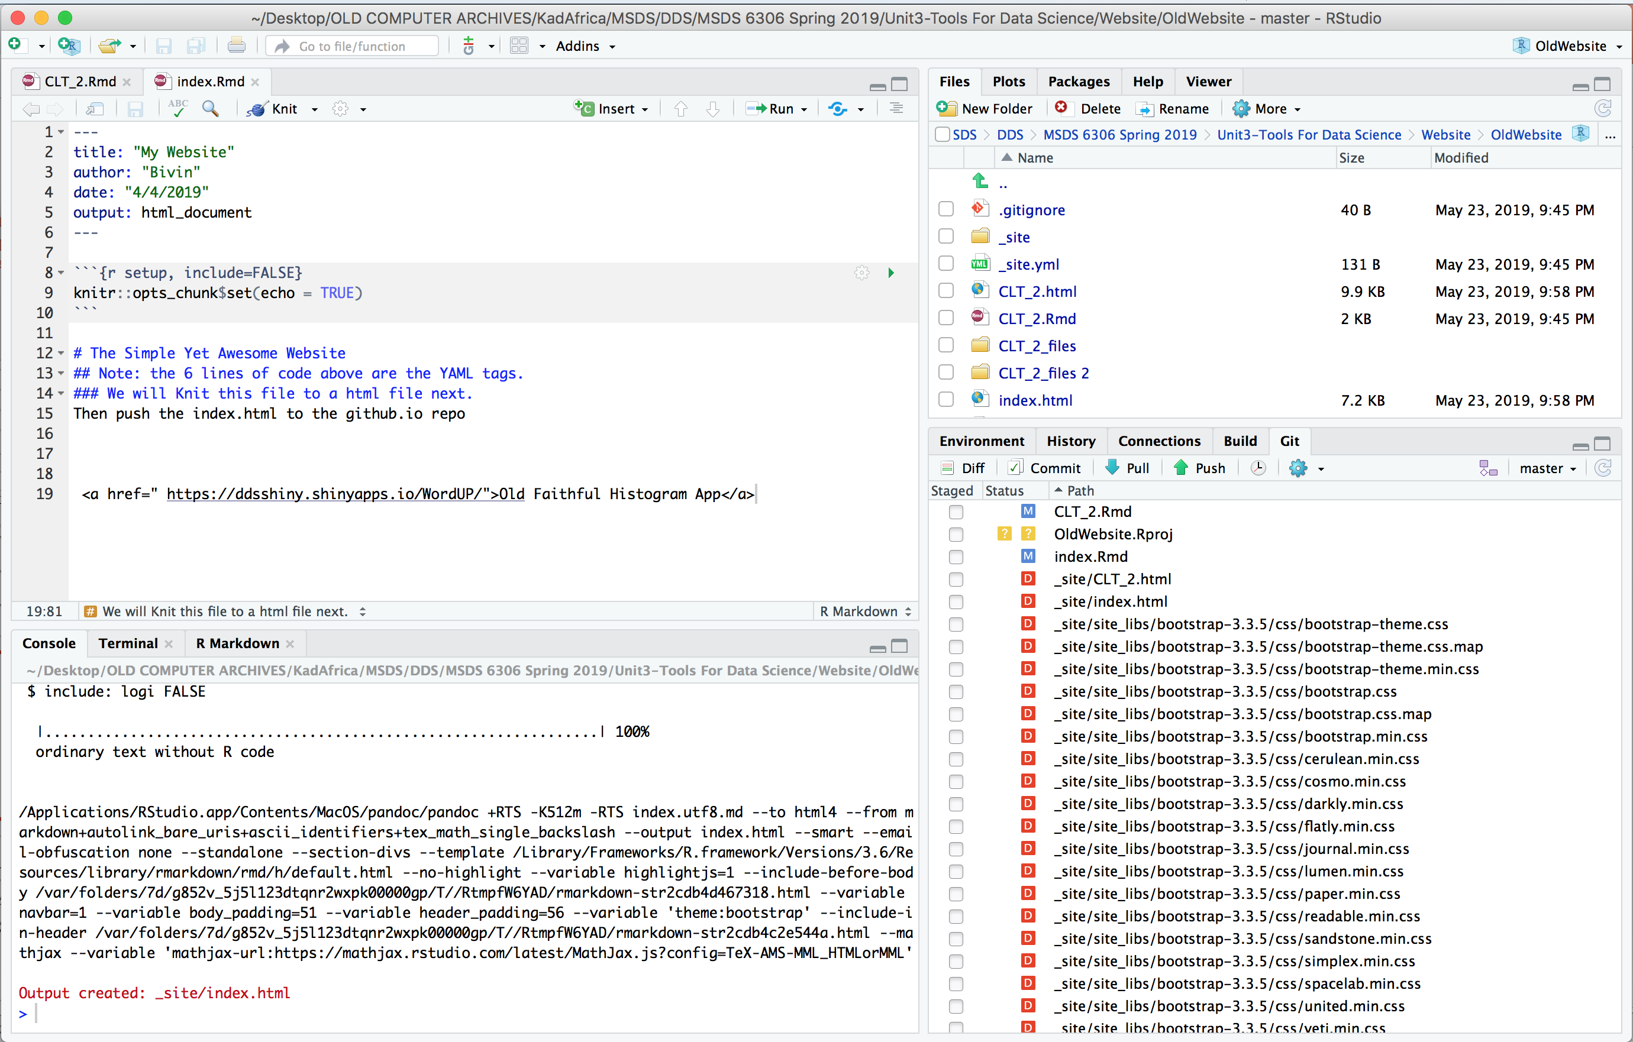
Websites with GitHub! | Simple + Shiny App

Slide 61
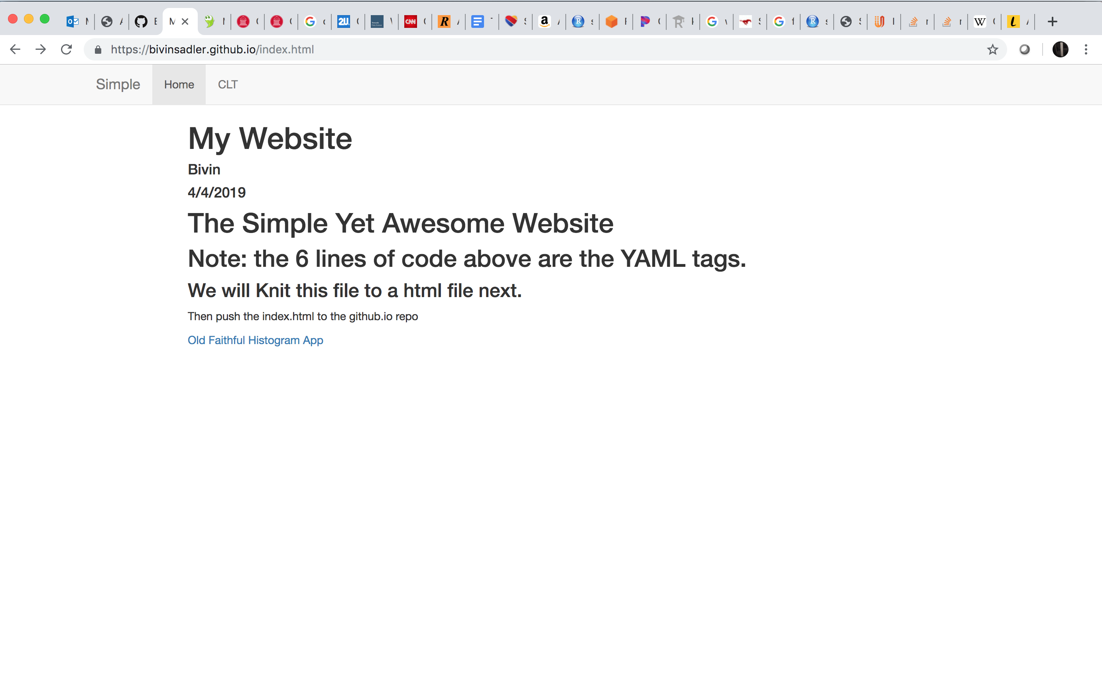
Websites with GitHub! | Simple + Shiny App

Slide 62
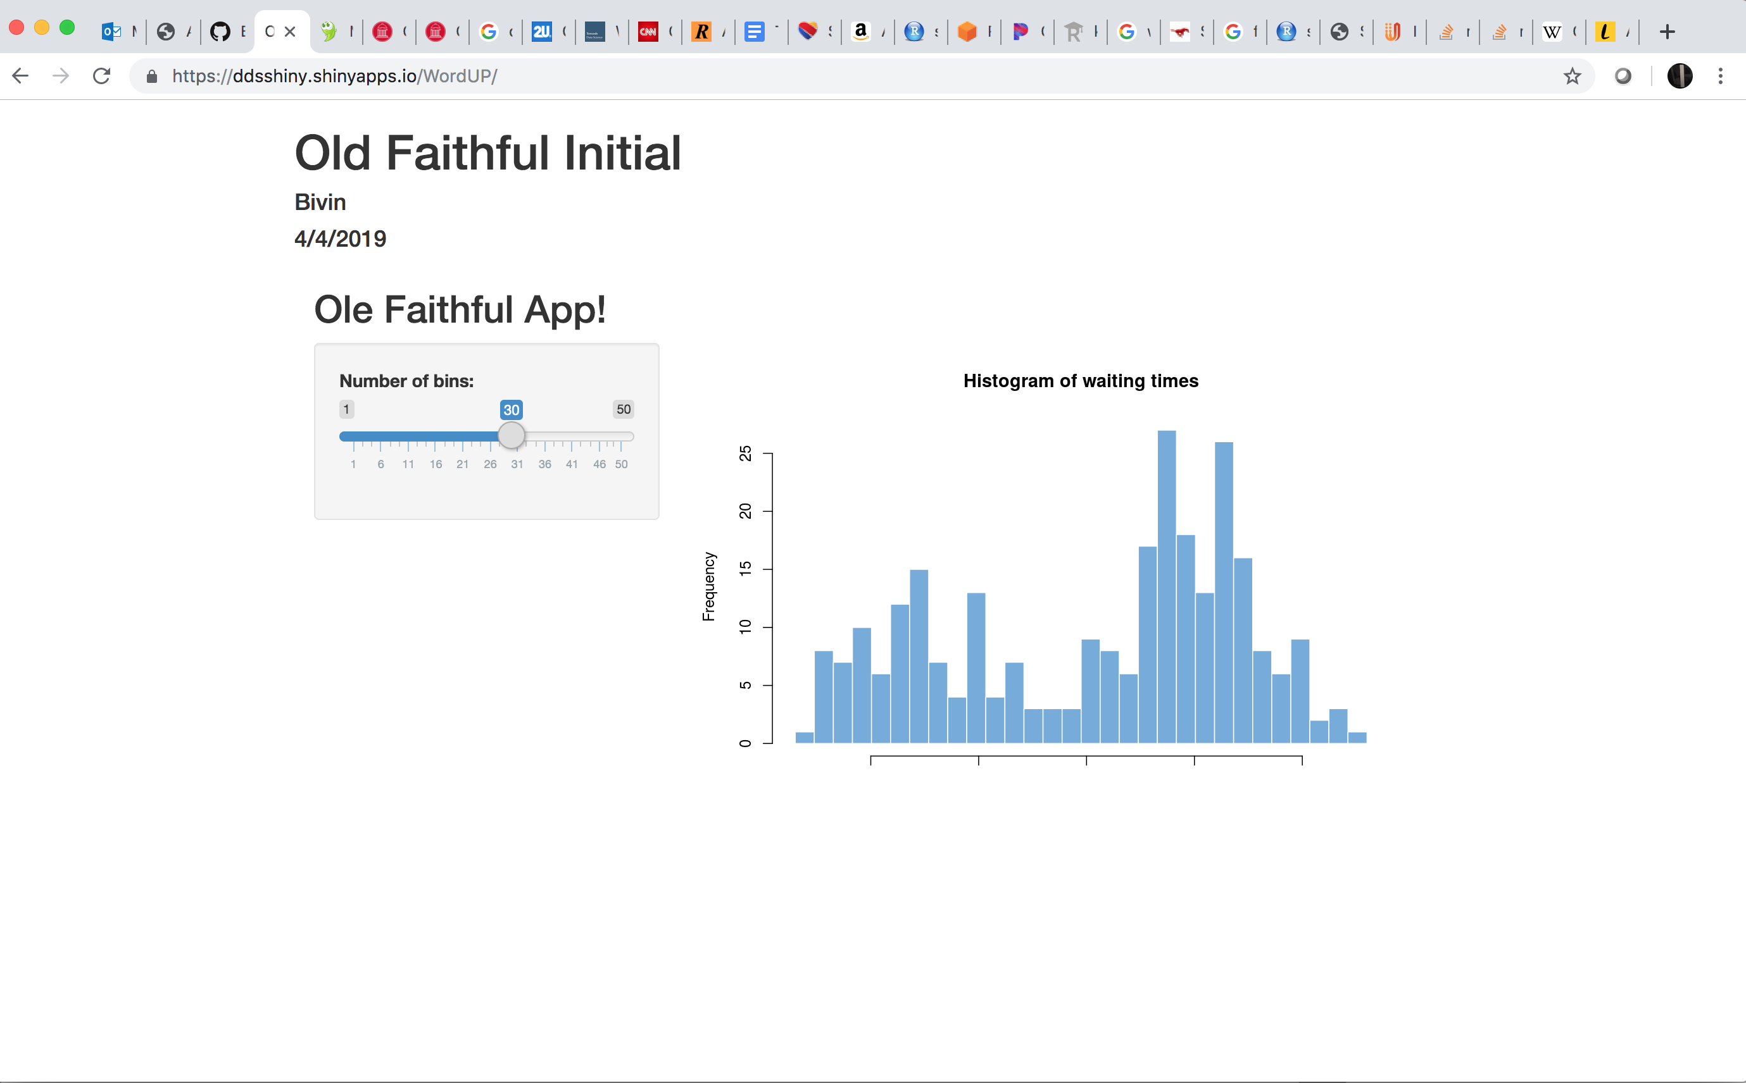
Websites with GitHub! | Simple + Shiny App

Slide 63
Websites with GitHub!
Files you need in root GitHub directory:
index.html
any other html docs from knitting Rmarkdown
_site.yml and all contents of the _site folder that results from render_site()
Note: Shiny Files can be in Rmarkdown documents but can’t be included in Github Pages websites.
HOWEVER! YOU CAN INCLUDE THEM AS HTML URL LINKS!!!! <a href = URL > Text </a>
Flow
Create a repository by the name of <username>.github.io
Clone the repository to a directory in RStudio
Create index.Rmd
Knit index.Rmd
Commit changes in the Git tab
Push changes in the Git tab
make all other Rmds
knit each Rmd to make html documents
make _site.yml (these are the instructions to combine all the html files into a nice looking website)
use package rmarkdown::render_site() to make/update _site directory
copy all contents of _site directory to the root directory of project
commit changes
Push Changes to GitHub
Check out your website!

